Slide 1
Introduction to Word Embeddings
Rudra Murthy
Staff Research Scientist,
IBM
Slides Credit:
Dr. Diptesh Kanojia, Dr. Kevin Patel

Slide 2
Outline
Introduction
One-Hot Encoding
Distributional Hypothesis
Word Representations
Count Based Approaches
Language Model
Word Representations
Prediction Based Approaches
Evaluating Word Embeddings
Word Debiasing

Slide 3
Encoding Words and Sentences
Consider the task of Sentiment Analysis
What is the sentiment of the following sentence?
I liked the movie
The car broke down. I hate the car.

Slide 4
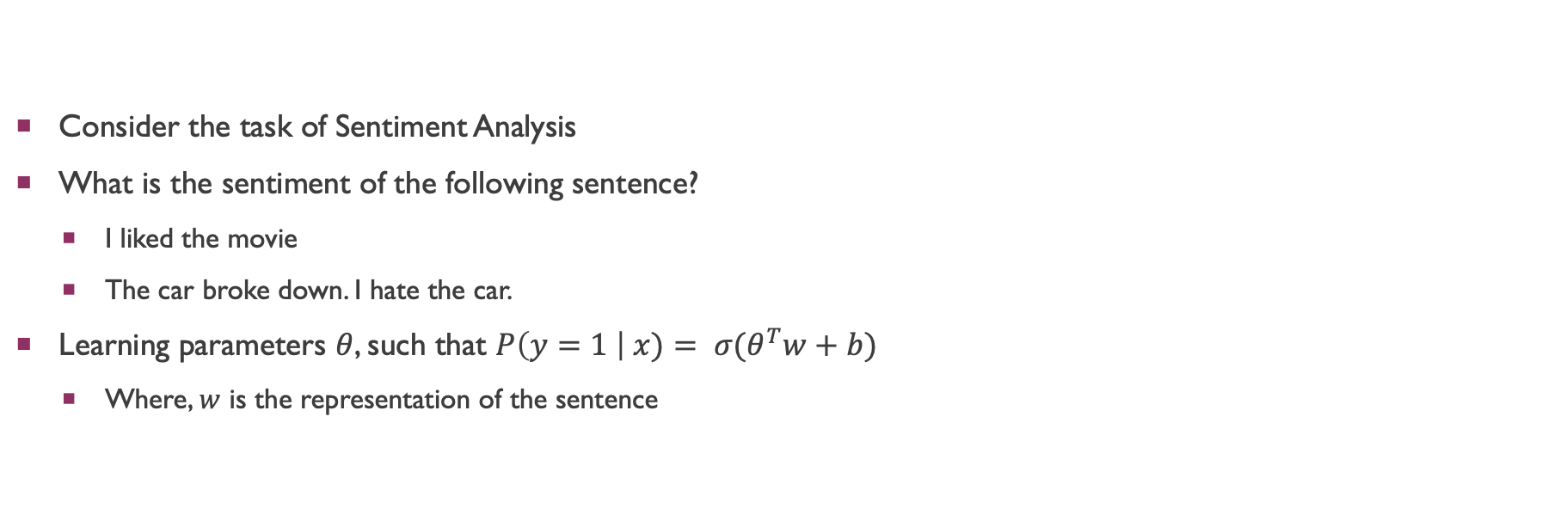
Encoding Words and Sentences
Consider the task of Sentiment Analysis
What is the sentiment of the following sentence?
I liked the movie
The car broke down. I hate the car.
Learning parameters $θ$, such that $P\left(y=1 \right| x)= σ(θ^{T}w+b)$
Where, $w$ is the representation of the sentence

Slide 5

Encoding Words and Sentences
Machine Learning requires encoding data in numeric form.
How do I go from words/sentences to numbers?
Consider the task of Sentiment Analysis
What is the sentiment of the following sentence?
I liked the movie
The car broke down. I hate the car.
Learning parameters $θ$, such that $P\left(y=1 \right| x)= σ(θ^{T}w+b)$
Where, $w$ is the representation of the sentence

Slide 6
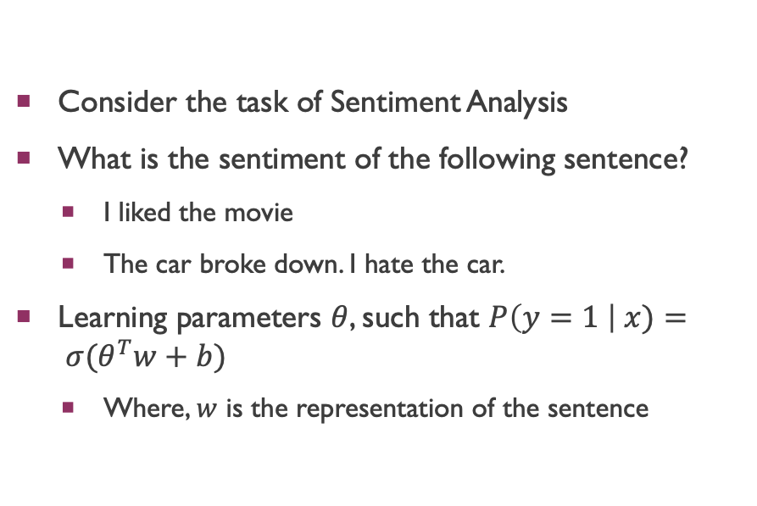
Encoding Words and Sentences
Consider the task of Sentiment Analysis
What is the sentiment of the following sentence?
I liked the movie
The car broke down. I hate the car.
Learning parameters $θ$, such that $P\left(y=1 \right| x)= σ(θ^{T}w+b)$
Where, $w$ is the representation of the sentence
Represent words as discrete symbols
Total unique words are = { I, liked, the, movie, car, broke, down, hate}
There are 8 unique words ➔ vector dimension
Represent them using a 8-bit vector
I | [1 0 0 0 0 0 0 0]
liked | [0 1 0 0 0 0 0 0]
the | [0 0 1 0 0 0 0 0]
movie | [0 0 0 1 0 0 0 0]
car | [0 0 0 0 1 0 0 0]
broke | [0 0 0 0 0 1 0 0]
down | [0 0 0 0 0 0 1 0]
hate | [0 0 0 0 0 0 0 1]

Slide 7
Encoding Words and Sentences
Represent words as discrete symbols
Total unique words are = { I, liked, the, movie, car, broke, down, hate}
There are 8 unique words ➔ vector dimension
Represent them using a 8-bit vector
Alternate way is to assign a unique index to every word, encode the word using binary form of the index
I | [1 0 0 0 0 0 0 0] | [0 0 0 0]
liked | [0 1 0 0 0 0 0 0] | [0 0 0 1]
the | [0 0 1 0 0 0 0 0] | [0 0 1 0]
movie | [0 0 0 1 0 0 0 0] | [0 0 1 1]
car | [0 0 0 0 1 0 0 0] | [0 1 0 0]
broke | [0 0 0 0 0 1 0 0] | [0 1 0 1]
down | [0 0 0 0 0 0 1 0] | [0 1 1 1]
hate | [0 0 0 0 0 0 0 1] | [1 0 0 0]

Slide 8
Encoding Words and Sentences
Represent words as discrete symbols
Total unique words are = {movie, car}
There are 2 unique words ➔ vector dimension
Represent them using a 2-bit vector
movie | [1 0]
car | [0 1]
car
movie

Slide 9
Encoding Words and Sentences
The representation of the sentence could be concatenation of all the word representations
I liked the movie
[1 0 0 0 0 0 0 0 0 1 0 0 0 0 0 0 0 0 1 0 0 0 0 0 0 0 0 1 0 0 0 0]
Alternate way is to sum the word representation of all the words in the sentence
Bag-of-words representation
I liked the movie [1 1 1 1 0 0 0 0]

Slide 10
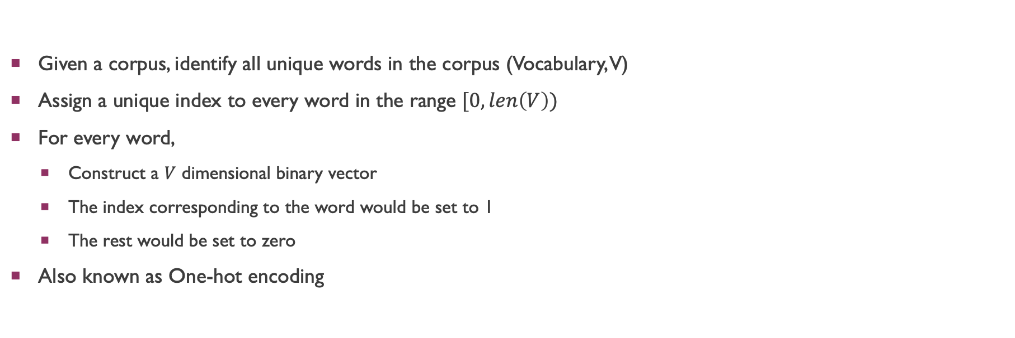
Encoding Words and Sentences
Given a corpus, identify all unique words in the corpus (Vocabulary, V)
Assign a unique index to every word in the range $[0, len\left(V\right))$
For every word,
Construct a $V$ dimensional binary vector
The index corresponding to the word would be set to 1
The rest would be set to zero
Also known as One-hot encoding
I | [1 0 0 0 0 0 0 0]
liked | [0 1 0 0 0 0 0 0]
the | [0 0 1 0 0 0 0 0]
movie | [0 0 0 1 0 0 0 0]
car | [0 0 0 0 1 0 0 0]
broke | [0 0 0 0 0 1 0 0]
down | [0 0 0 0 0 0 1 0]
hate | [0 0 0 0 0 0 0 1]

Slide 11
Encoding Words: One-Hot Representation
lunch | [1 0]
dinner | [0 1]
Consider vectorial representation of lunch and dinner
lunch = [1 0 0 …. 0]
dinner = [0 1 0 …. 0]
How to compute similarity between two words?
Dot-product
Sim( lunch, dinner) = [1 0 0 …. 0]^{T} [0 1 0 …. 0] = 0
No notion of similarity between similar words
lunch
dinner

Slide 12
Distributional Hypothesis

Slide 13
Distributional Hypothesis
Consider the following sentences
I ate X yesterday
X is prepared from jaggery and maida
X is also served with ghee
Can we say something about X?

Slide 14
Distributional Hypothesis
Consider the following sentences
I ate X yesterday
X is prepared from jaggery and maida
X is also served with ghee
Can we say something about X?
Harris (1954): Words that occur in the same contexts tend to have similar meanings
Firth (1957): A word is characterized by the company it keeps

Slide 15
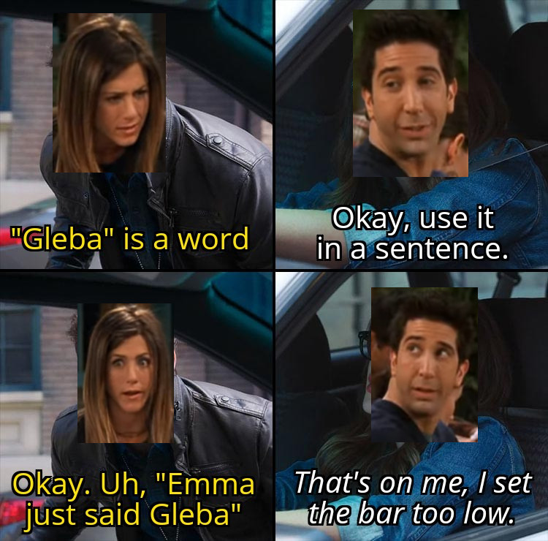
Distributional Hypothesis
Consider the following sentences
I ate X yesterday
X is prepared from jaggery and maida
X is also served with ghee
Can we say something about X?
Harris (1954): Words that occur in the same contexts tend to have similar meanings
Firth (1957): A word is characterized by the company it keeps
Source: https://www.reddit.com/r/howyoudoin/comments/oo3am4/emma_just_said_gleba/

Slide 16
Word Representations
Count Based Approaches

Slide 17
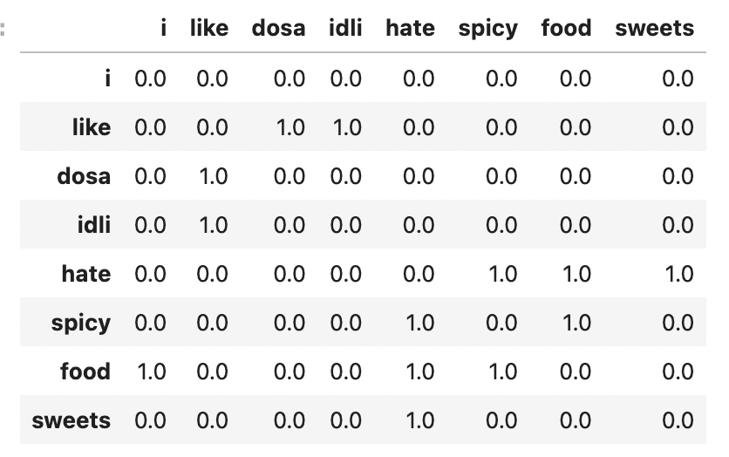
Word Representations
Word Co-Occurrence Matrix
Consider the following text
I like dosa
I like idli
I hate spicy food
I hate sweets
Source: https://www.gutenberg.org/files/2591/2591-0.txt

Slide 18
Word Representations
Word Co-Occurrence Matrix
Frequent words dominate the vectors
We can use weighting scheme like TF-IDF or PMI
Use Stop-word removal to retain only content words

Slide 19
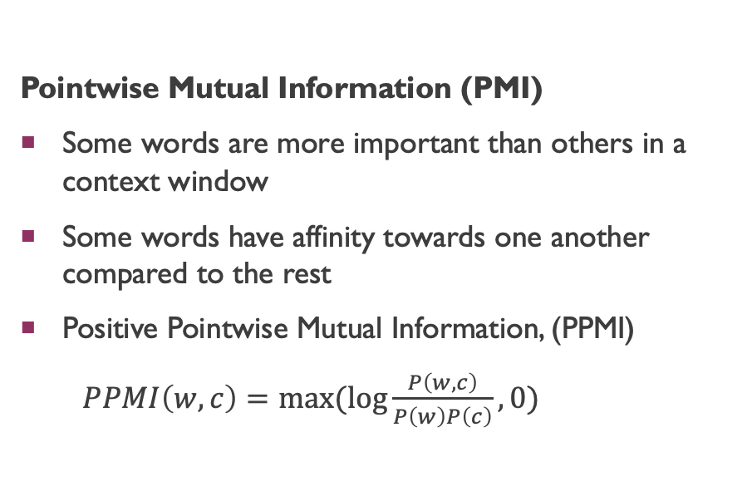
Word Representations
Pointwise Mutual Information (PMI)
Some words are more important than others in a context window
Some words have affinity towards one another compared to the rest
Positive Pointwise Mutual Information, (PPMI)
$PPMI\left(w,c\right)=max⁡(\log{\frac{P\left(w,c\right)}{P\left(w\right)P\left(c\right)}}, 0)$
TF-IDF Matrix
Use Term Frequency (TF) and Inverse Document Frequency (IDF) to calculate the strength between two co-occurring words in a context
TF-IDF(t, d, D) = tf(t, D) x idf(t, D)

Slide 20
Word Representations
Vectors obtained from co-occurrence with PMI or TF-IDF processing is still sparse
Captures some notion of word similarity
Need to reduce dimensions to handle the curse of dimensionality
Usually, Singular Valued Decomposition is applied on the co-occurrence matrix to reduce dimensions

Slide 21
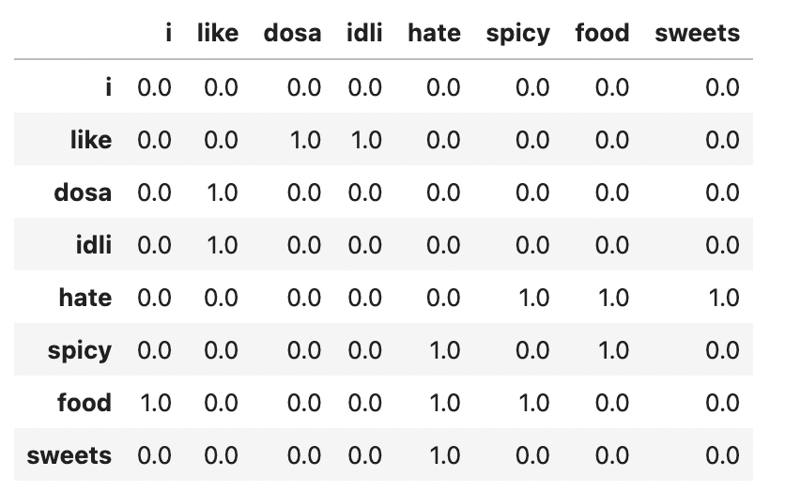
Word Representations
Why Dense Representations?
Lower dimensionality ➔ Curse of Dimensionality
Capture word similarity
Similar words should be near in the embedding/vector space

Slide 22
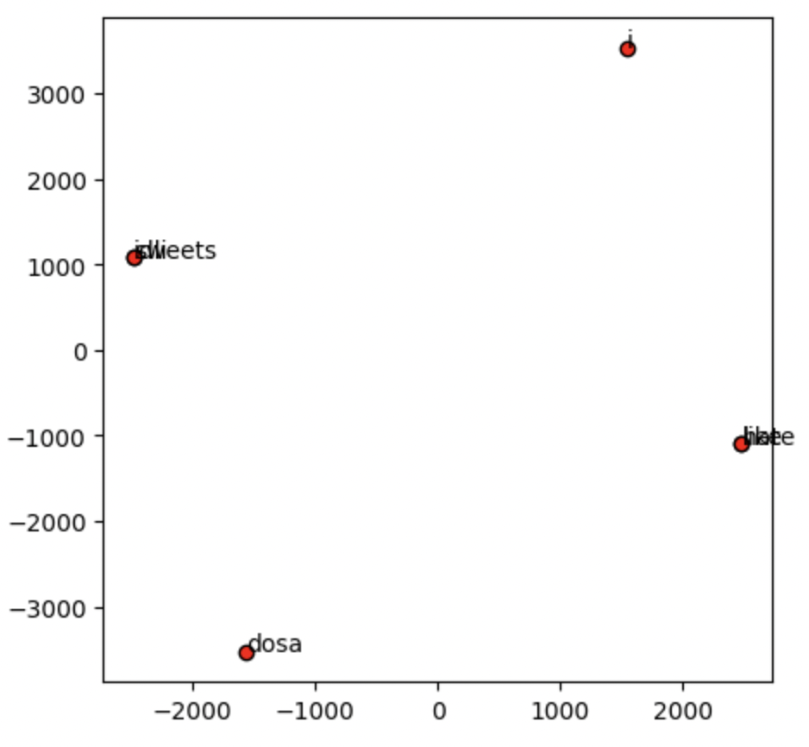
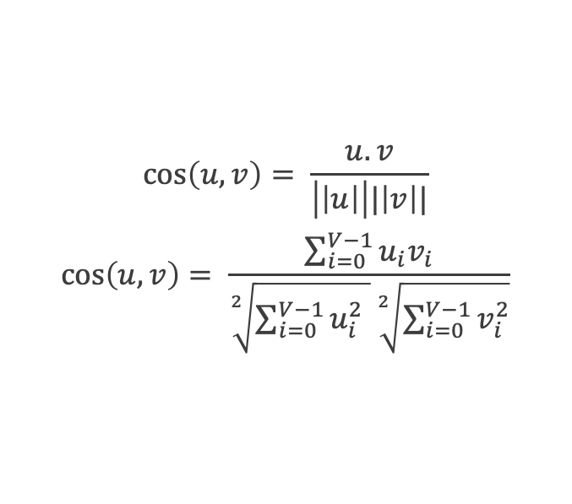
Word Similarity
$$\cos\left(u,v\right)= \frac{u.v}{\left|\left|u\right|\right||\left|v\right||}$$
$$\cos\left(u,v\right)= \frac{\sum_{i=0}^{V−1}{u_{i}v_{i}}}{\sqrt[2]{\sum_{i=0}^{V−1}{u_{i}^{2} }}\sqrt[2]{\sum_{i=0}^{V−1}{v_{i}^{2}}}}$$

Slide 23
Relevant Literature
Sahlgren, Magnus (2006). The Word-Space Model (PDF) (PhD thesis). Stockholm University.
Sahlgren, Magnus (2008). "The Distributional Hypothesis" (PDF). Rivista di Linguistica. 20 (1): 33–53.

Slide 24
History of Language Models
Rudra Murthy

Slide 25
Outline
Introduction
n-gram Language Model
Neural Probabilistic Language Model
Recurrent Neural Network Language Model
Unsupervised Pre-Training: A glimpse
1990s
2003
2009

Slide 26
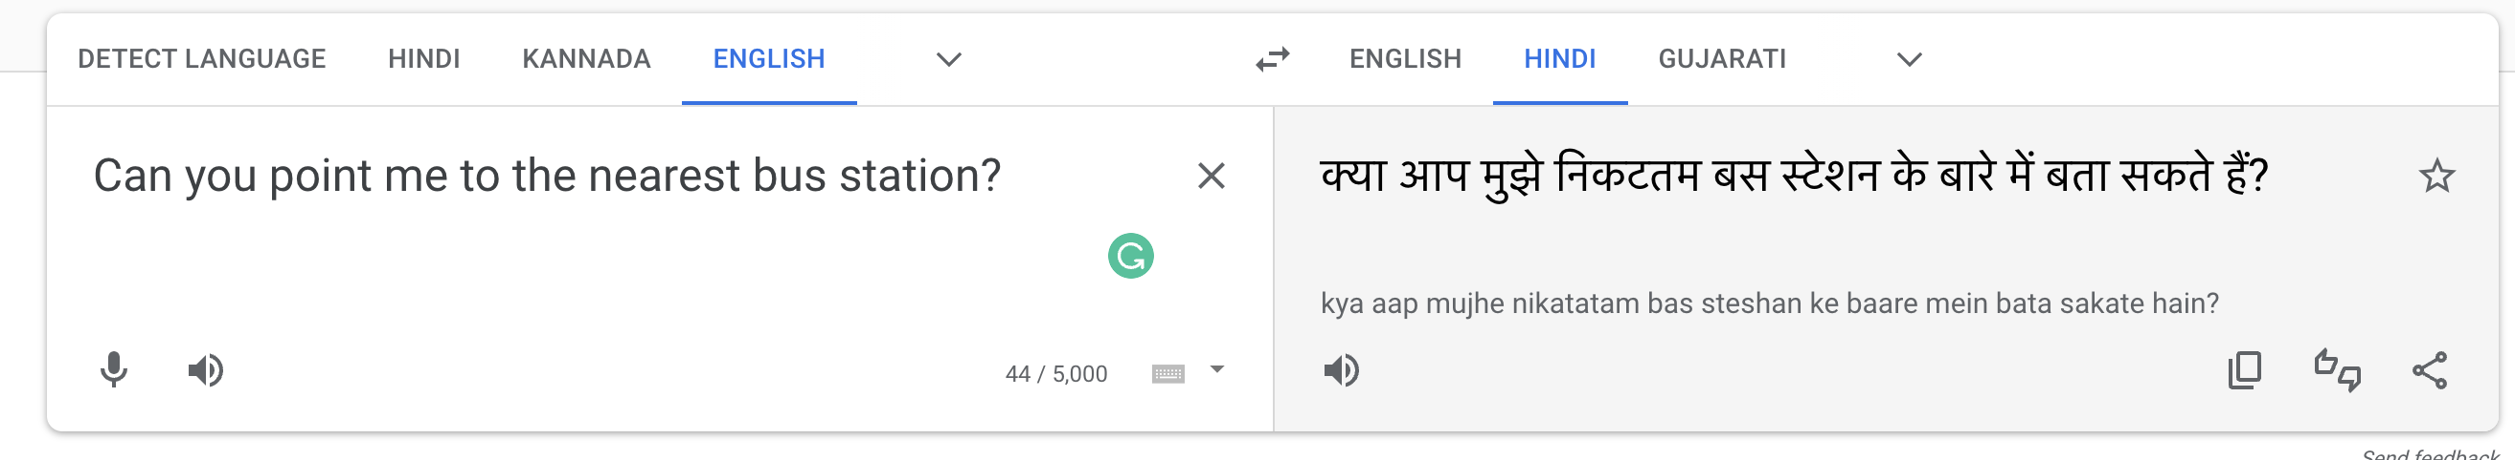
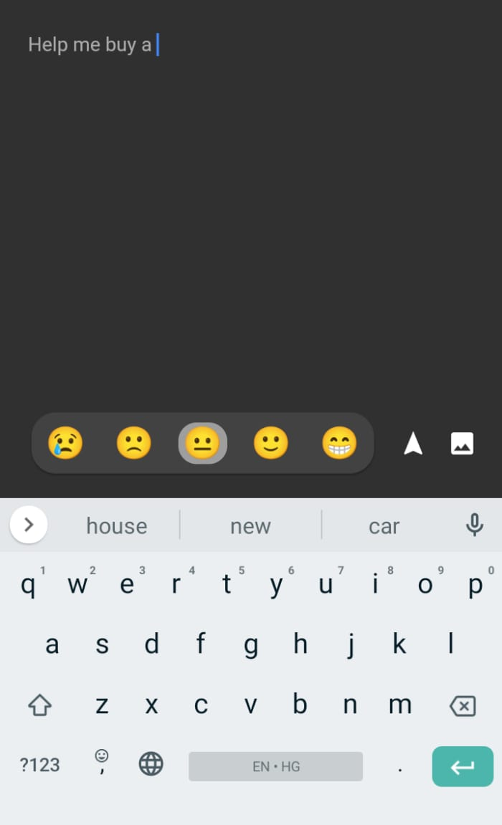
Introduction
Why Language Model?
We need a method to assign
high probability to grammatical sentences
Low probability to ungrammatical ones
For example:
P(The sun rises in the east) > P(The sun rises in the west)
P(The sun rises in the east) > P(The sun rise in the east)
P(The sun rises in the east) > P(The son rises in the east)

Slide 27
n-gram Language Model
Introduction

Slide 28
N-GRAM LANGUAGE MODEL
Applications:
Assume that we have seen some sequence of words (h) and we need to choose the next word (w)
For example, we have observed the sequence I went to the and we want to know what is the probability that the next word is market
P( market | I went to the )
How do we estimate this?
Or, I need to estimate how good the generated sentence (X) is?
For example, the model generates I went to the ground and we want to know
P( I went to the ground )

Slide 29
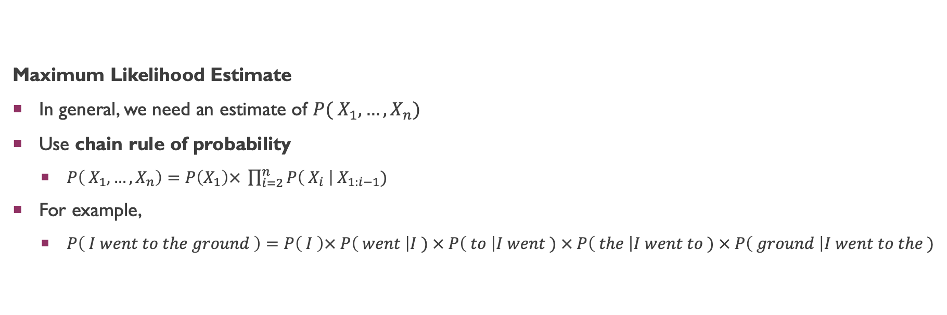
N-GRAM LANGUAGE MODEL
Maximum Likelihood Estimate
In general, we need an estimate of $P( X_{1}, …,X_{n})$
Use chain rule of probability
$P\left( X_{1}, …,X_{n}\right)=P\left(X_{1}\right)× \prod_{i=2}^{n}{P\left( X_{i} \right| X_{1:i−1})}$
For example,
$P\left( I went to the ground \right)=P\left( I \right)× P\left( went \right|I ) × P\left( to \right|I went ) × P\left( the \right|I went to ) × P\left( ground \right|I went to the )$
# https://books.google.com/ngrams/

Slide 30
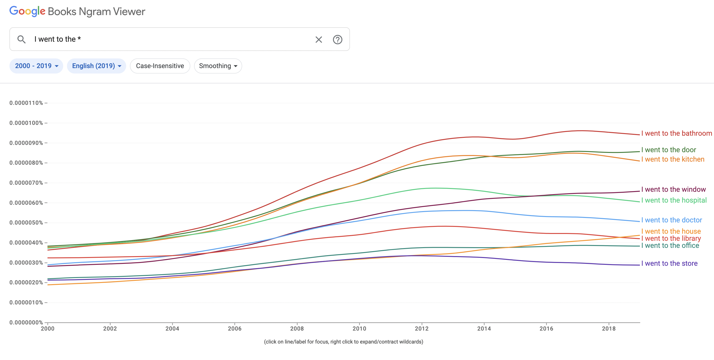
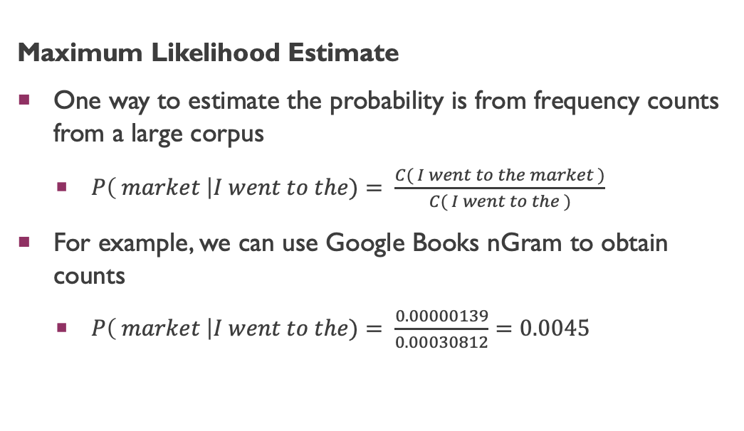
N-GRAM LANGUAGE MODEL
Maximum Likelihood Estimate
One way to estimate the probability is from frequency counts from a large corpus
$P\left( market \right|I went to the)= \frac{C( I went to the market )}{C( I went to the )}$
For example, we can use Google Books nGram to obtain counts
$P\left( market \right|I went to the)= \frac{0.00000139}{0.00030812}=0.0045$
# https://books.google.com/ngrams/

Slide 31
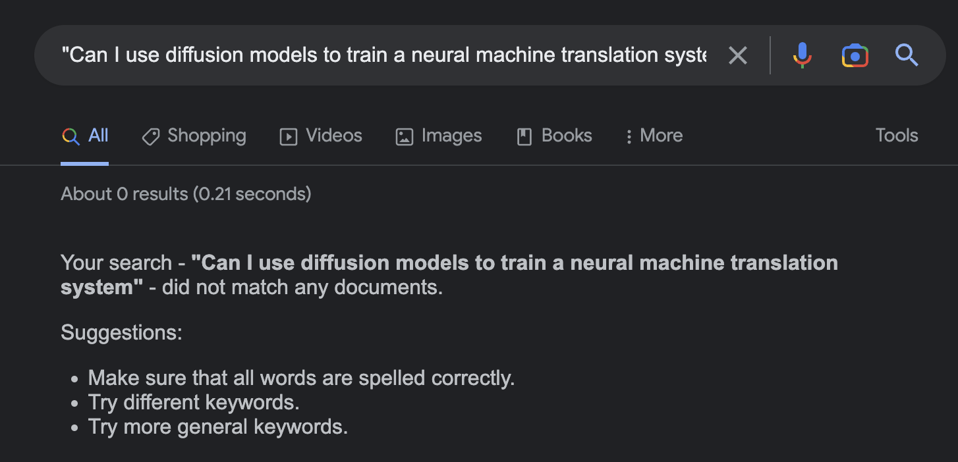
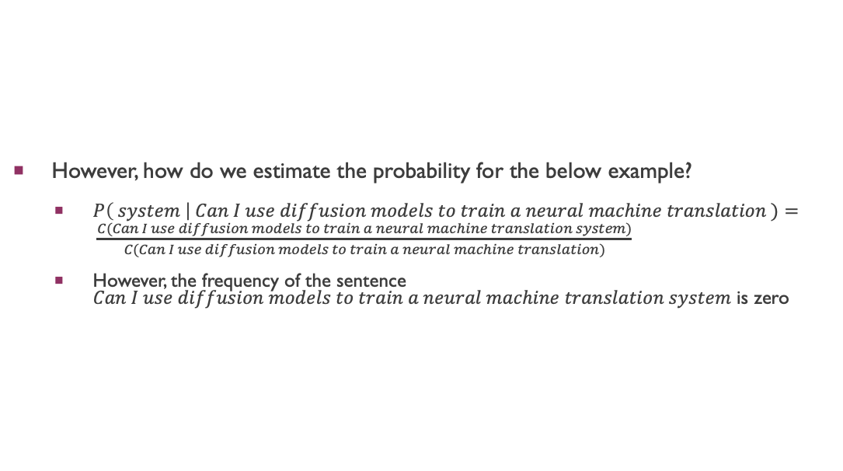
N-GRAM LANGUAGE MODEL
However, how do we estimate the probability for the below example?
$P\left( system \right| Can I use diffusion models to train a neural machine translation )= \frac{C(Can I use diffusion models to train a neural machine translation system)}{C(Can I use diffusion models to train a neural machine translation)}$
However, the frequency of the sentence $Can I use diffusion models to train a neural machine translation system$ is zero

Slide 32
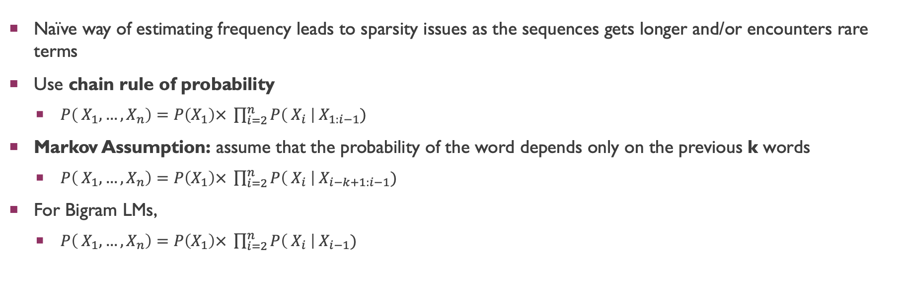
N-GRAM LANGUAGE MODEL
Naïve way of estimating frequency leads to sparsity issues as the sequences gets longer and/or encounters rare terms
Use chain rule of probability
$P\left( X_{1}, …,X_{n}\right)=P\left(X_{1}\right)× \prod_{i=2}^{n}{P\left( X_{i} \right| X_{1:i−1})}$
Markov Assumption: assume that the probability of the word depends only on the previous k words
$P\left( X_{1}, …,X_{n}\right)=P\left(X_{1}\right)× \prod_{i=2}^{n}{P\left( X_{i} \right| X_{i−k+1:i−1})}$
For Bigram LMs,
$P\left( X_{1}, …,X_{n}\right)=P\left(X_{1}\right)× \prod_{i=2}^{n}{P\left( X_{i} \right| X_{i−1})}$

Slide 33
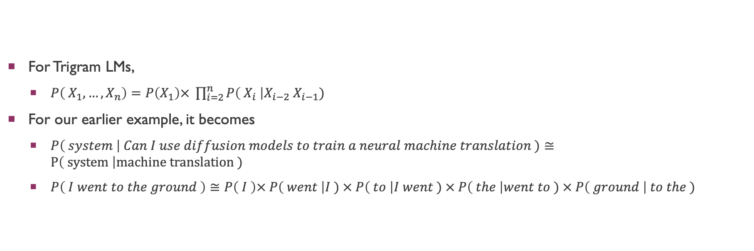
N-GRAM LANGUAGE MODEL
For Trigram LMs,
$P\left( X_{1}, …,X_{n}\right)=P\left(X_{1}\right)× \prod_{i=2}^{n}{P\left( X_{i} \right|X_{i−2} X_{i−1})}$
For our earlier example, it becomes
$P\left( system \right| Can I use diffusion models to train a neural machine translation )≅P\left( system \right|machine translation )$
$P\left( I went to the ground \right)≅P\left( I \right)× P\left( went \right|I ) × P\left( to \right|I went ) × P\left( the \right|went to ) × P\left( ground \right| to the )$

Slide 34
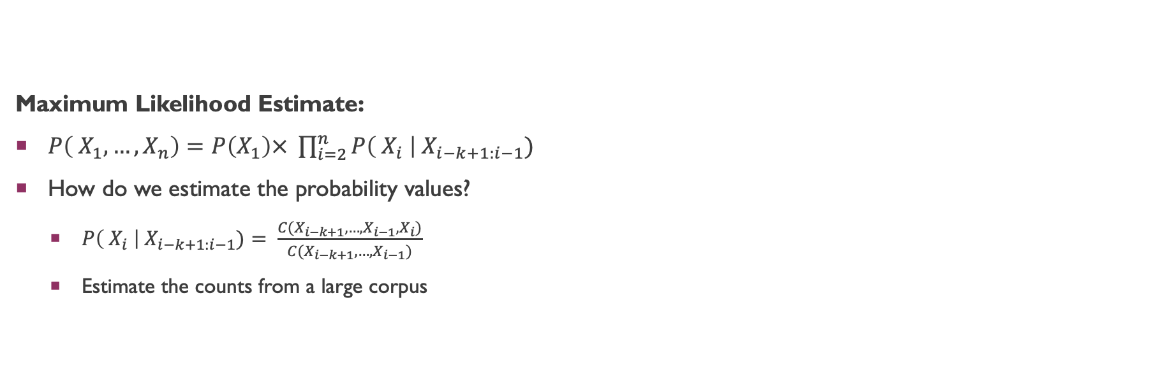
N-GRAM LANGUAGE MODEL: MLE
Maximum Likelihood Estimate:
$P\left( X_{1}, …,X_{n}\right)=P\left(X_{1}\right)× \prod_{i=2}^{n}{P\left( X_{i} \right| X_{i−k+1:i−1})}$
How do we estimate the probability values?
$P\left( X_{i} \right| X_{i−k+1:i−1})= \frac{C(X_{i−k+1}, …, X_{i−1},X_{i})}{C(X_{i−k+1}, …, X_{i−1})}$
Estimate the counts from a large corpus

Slide 35
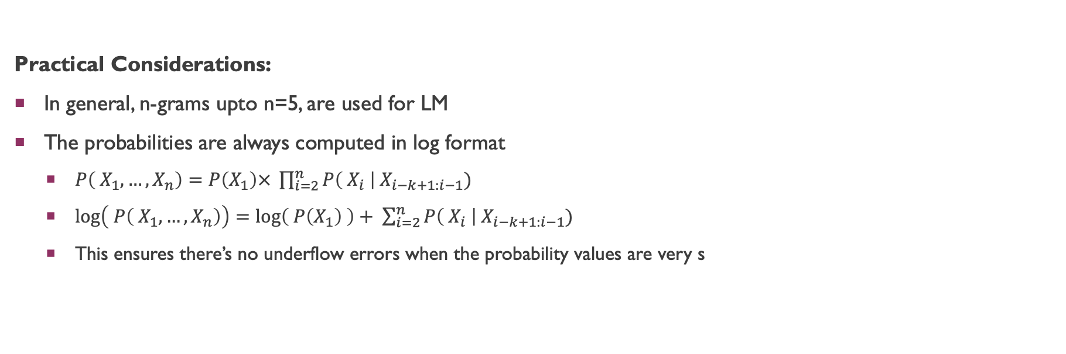
N-GRAM LANGUAGE MODEL
Practical Considerations:
In general, n-grams upto n=5, are used for LM
The probabilities are always computed in log format
$P\left( X_{1}, …,X_{n}\right)=P\left(X_{1}\right)× \prod_{i=2}^{n}{P\left( X_{i} \right| X_{i−k+1:i−1})}$
$\log\left( P\left( X_{1}, …,X_{n}\right)\right)=\log\left( P\left(X_{1}\right) \right)+ \sum_{i=2}^{n}{P\left( X_{i} \right| X_{i−k+1:i−1})}$
This ensures there’s no underflow errors when the probability values are very s

Slide 36
n-gram Language Model
Evaluation

Slide 37
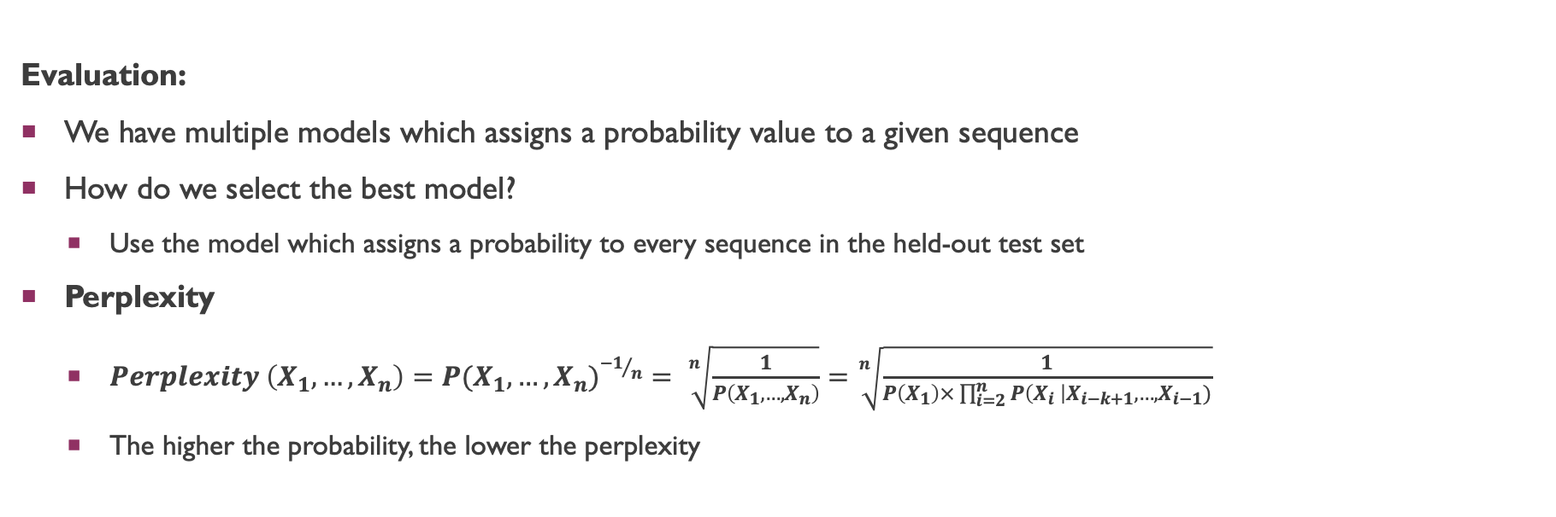
N-GRAM LANGUAGE MODEL
Evaluation:
We have multiple models which assigns a probability value to a given sequence
How do we select the best model?
Use the model which assigns a probability to every sequence in the held-out test set
Perplexity
$Perplexity \left(X_{1}, …, X_{n}\right)=P(X_{1}, …, X_{n})^{{−1}/n}= \sqrt[n]{\frac{1}{P\left(X_{1}, …, X_{n}\right)}}=\sqrt[n]{\frac{1}{P\left(X_{1}\right)×\prod_{i=2}^{n}{P\left(X_{i} \right|X_{i−k+1}, …, X_{i−1})}}}$
The higher the probability, the lower the perplexity

Slide 38
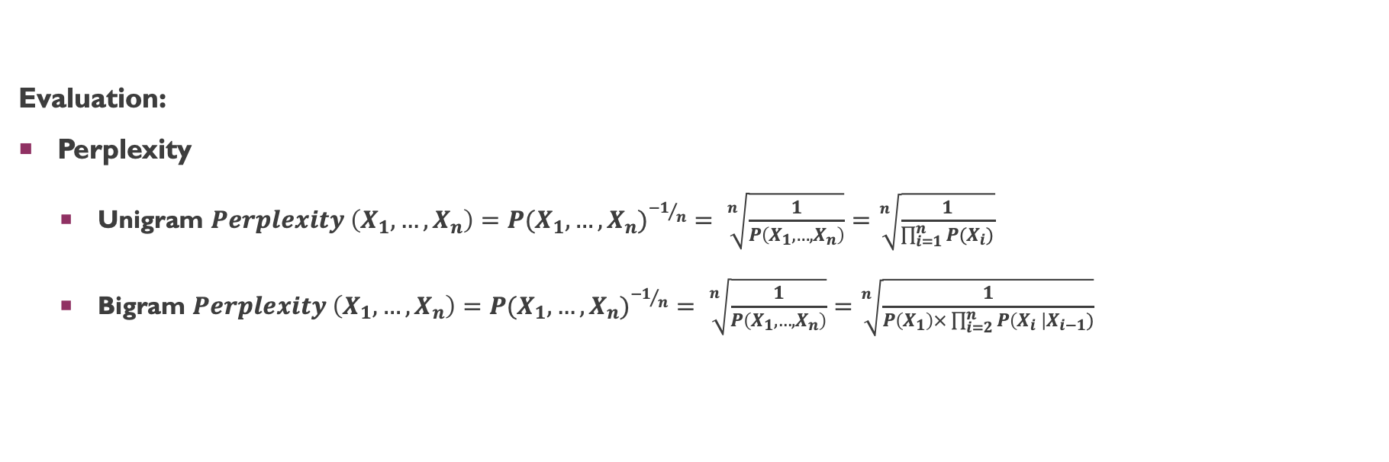
N-GRAM LANGUAGE MODEL
Evaluation:
Perplexity
Unigram $Perplexity \left(X_{1}, …, X_{n}\right)=P(X_{1}, …, X_{n})^{{−1}/n}= \sqrt[n]{\frac{1}{P\left(X_{1}, …, X_{n}\right)}}=\sqrt[n]{\frac{1}{\prod_{i=1}^{n}{P(X_{i})}}}$
Bigram $Perplexity \left(X_{1}, …, X_{n}\right)=P(X_{1}, …, X_{n})^{{−1}/n}= \sqrt[n]{\frac{1}{P\left(X_{1}, …, X_{n}\right)}}=\sqrt[n]{\frac{1}{P\left(X_{1}\right)×\prod_{i=2}^{n}{P\left(X_{i} \right|X_{i−1})}}}$

Slide 39
N-GRAM LANGUAGE MODEL
Unknown Words
How to handle unknown words?
Create a new token <UNK>
replace all words in training data whose frequency is below the threshold with <UNK>
Compute the probabilities

Slide 40
n-gram Language Model
Smoothing, Back-oFf, and, Interpolation

Slide 41
N-GRAM LANGUAGE MODEL
Smoothing
What to do if a particular n-gram do not appear in the corpus?
Diffusion Neural Language Model
The model assigns zero probability to such n-grams
Borrow a bit of probability from frequent events and assign it to unseen events

Slide 42
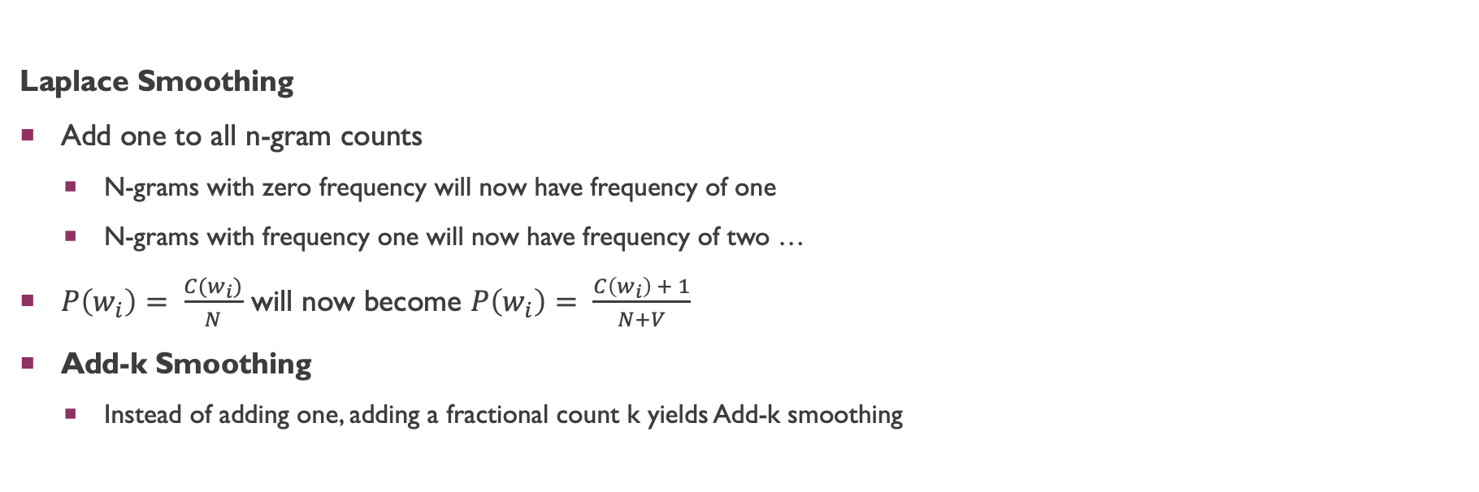
N-GRAM LANGUAGE MODEL
Laplace Smoothing
Add one to all n-gram counts
N-grams with zero frequency will now have frequency of one
N-grams with frequency one will now have frequency of two …
$P\left(w_{i}\right)= \frac{C(w_{i})}{N}$ will now become $P\left(w_{i}\right)= \frac{C\left(w_{i}\right) + 1}{N+V}$
Add-k Smoothing
Instead of adding one, adding a fractional count k yields Add-k smoothing

Slide 43
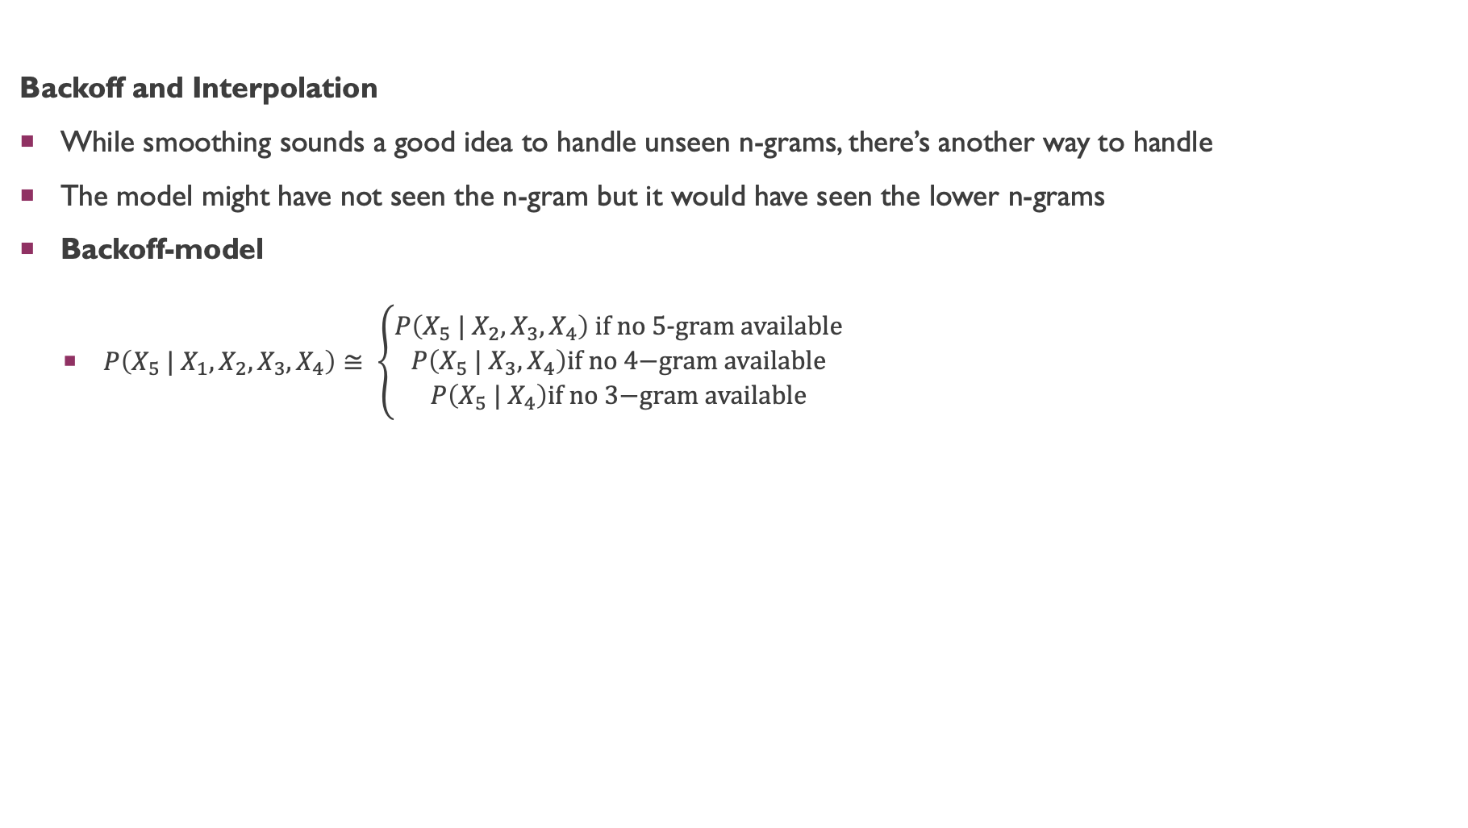
N-GRAM LANGUAGE MODEL
Backoff and Interpolation
While smoothing sounds a good idea to handle unseen n-grams, there’s another way to handle
The model might have not seen the n-gram but it would have seen the lower n-grams
Backoff-model
$P\left(X_{5} | X_{1},X_{2},X_{3},X_{4}\right)≅ \left\{\begin{aligned}P\left(X_{5} | X_{2},X_{3},X_{4}\right) \text{if} \text{no}\text{ 5−}\text{gram} \text{available} \\ P\left(X_{5} | X_{3},X_{4}\right)\text{if} \text{no}\text{ 4−}\text{gram} \text{available} \\ P\left(X_{5} | X_{4}\right)\text{if} \text{no}\text{ 3−}\text{gram} \text{available}\end{aligned}\right.$

Slide 44
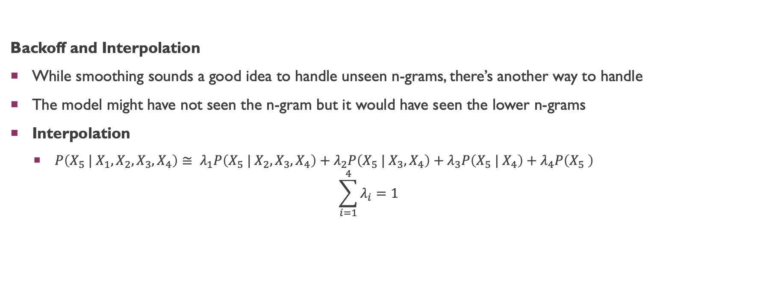
N-GRAM LANGUAGE MODEL
Backoff and Interpolation
While smoothing sounds a good idea to handle unseen n-grams, there’s another way to handle
The model might have not seen the n-gram but it would have seen the lower n-grams
Interpolation
$P\left(X_{5} | X_{1},X_{2},X_{3},X_{4}\right)≅ λ_{1}P\left(X_{5} | X_{2},X_{3},X_{4}\right)+λ_{2}P\left(X_{5} | X_{3},X_{4}\right)+λ_{3}P\left(X_{5} | X_{4}\right)+λ_{4}P\left(X_{5} \right)$ $\sum_{i=1}^{4}{λ_{i}=1}$

Slide 45
n-gram Language Model
CLASS Based n-gram Language Model

Slide 46
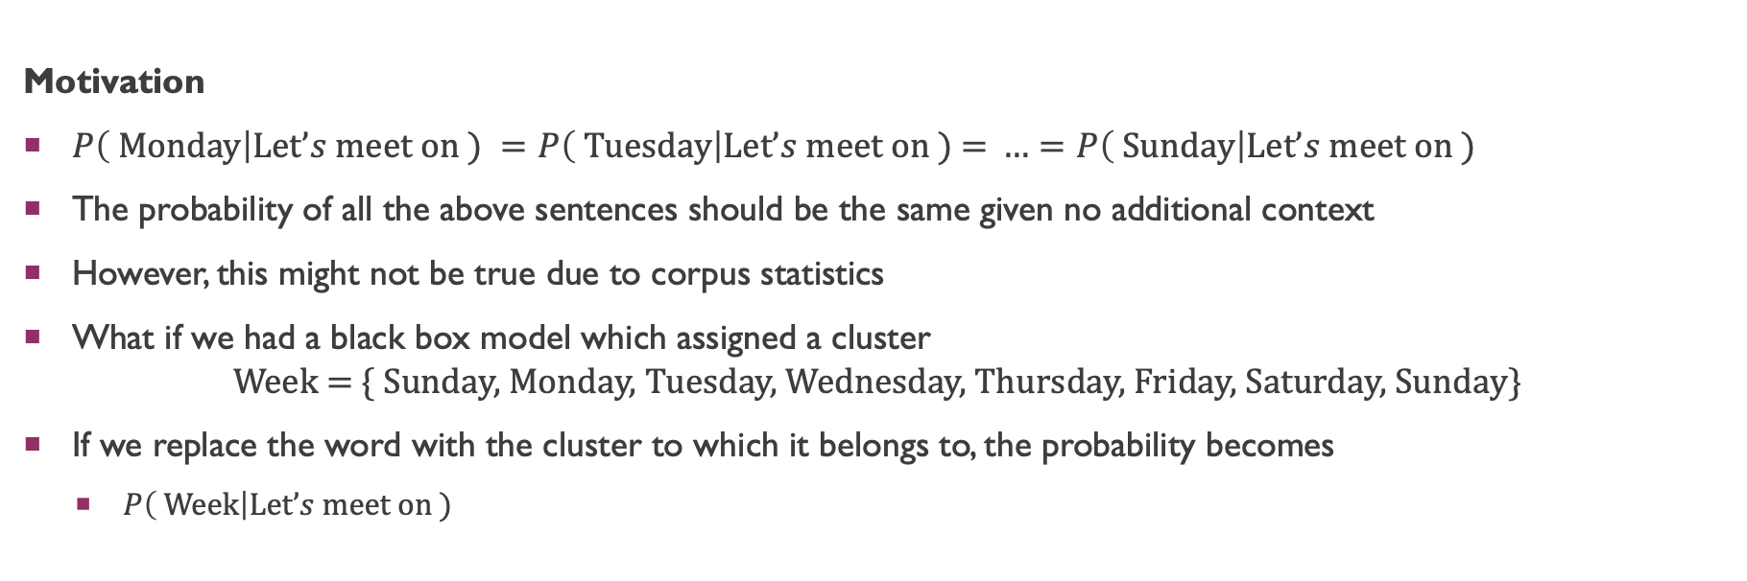
CLASS Based n-gram Language Model
Motivation
$P\left( \text{Monday}\right|\text{Let}’s \text{meet} \text{on}\text{ ) }=P\left( \text{Tues}\text{day}\right|\text{Let}’s \text{meet} \text{on}\text{ ) = }…=P\left( \text{Sunday}\right|\text{Let}’s \text{meet} \text{on}\text{ )}$
The probability of all the above sentences should be the same given no additional context
However, this might not be true due to corpus statistics
What if we had a black box model which assigned a cluster $\text{Week}\text{ = \{ }\text{Sunday}\text{, }\text{Monday}\text{, }\text{Tuesday}\text{, }\text{Wednesday}\text{, }\text{Thursday}\text{, }\text{Friday}\text{, }\text{Saturday}\text{, }\text{Sunday}\text{\}}$
If we replace the word with the cluster to which it belongs to, the probability becomes
$P\left( \text{Week}\right|\text{Let}’s \text{meet} \text{on}\text{ )}$

Slide 47
n-gram Language Model
POS Based n-gram Language Model

Slide 48
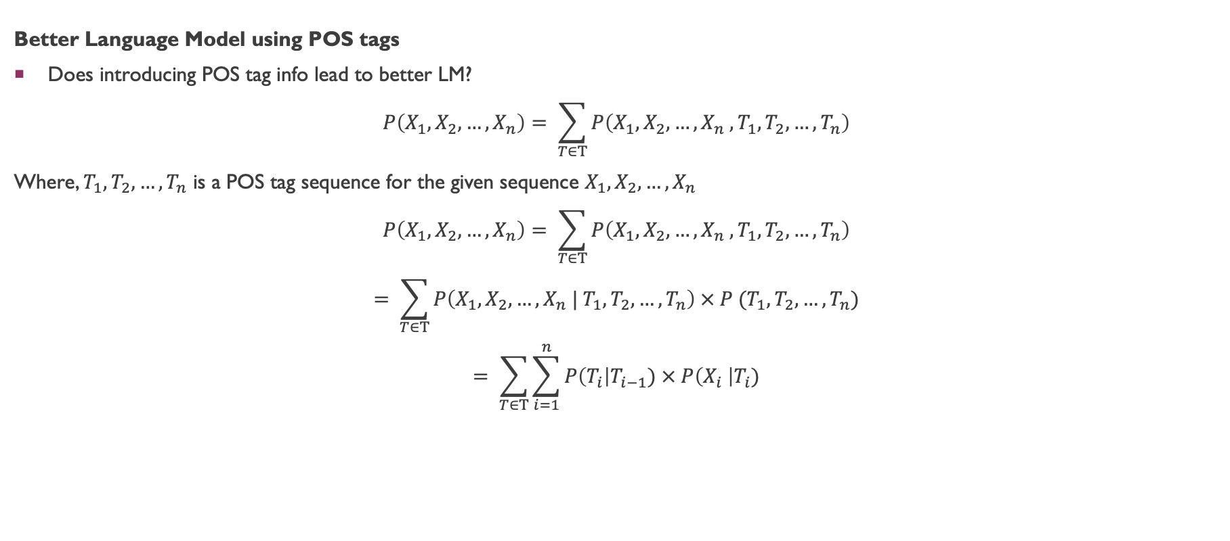
N-GRAM LANGUAGE MODEL
Better Language Model using POS tags
Does introducing POS tag info lead to better LM?
$$P\left(X_{1},X_{2}, …,X_{n}\right)= \sum_{T∈Τ}{P\left(X_{1},X_{2}, …,X_{n} , T_{1},T_{2}, …,T_{n}\right)}$$
Where, $T_{1},T_{2}, …,T_{n}$ is a POS tag sequence for the given sequence $X_{1},X_{2}, …,X_{n}$
$$P\left(X_{1},X_{2}, …,X_{n}\right)= \sum_{T∈Τ}{P\left(X_{1},X_{2}, …,X_{n} , T_{1},T_{2}, …,T_{n}\right)}$$
$$= \sum_{T∈Τ}{P\left(X_{1},X_{2}, …,X_{n} | T_{1},T_{2}, …,T_{n}\right) × P (T_{1},T_{2}, …,T_{n})}$$
$$= \sum_{T∈Τ}{\sum_{i=1}^{n}{P\left(T_{i}\right|T_{i−1}) × P\left(X_{i} \right|T_{i})}}$$

Slide 49
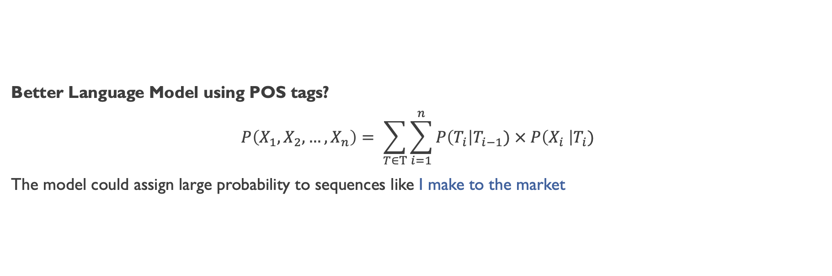
N-GRAM LANGUAGE MODEL
Better Language Model using POS tags?
$$P\left(X_{1},X_{2}, …,X_{n}\right)= \sum_{T∈Τ}{\sum_{i=1}^{n}{P\left(T_{i}\right|T_{i−1}) × P\left(X_{i} \right|T_{i})}}$$
The model could assign large probability to sequences like I make to the market

Slide 50
n-gram Language Model
Parse-Tree Based n-gram Language Model

Slide 51
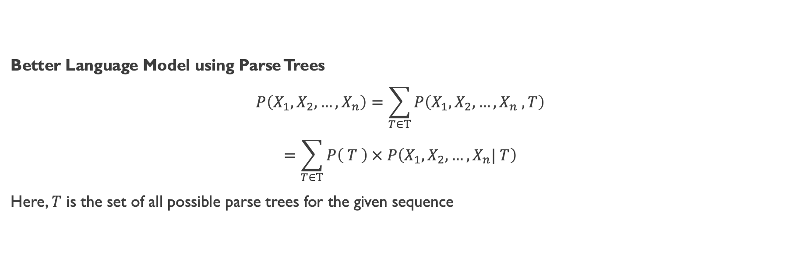
N-GRAM LANGUAGE MODEL
Better Language Model using Parse Trees
$$P\left(X_{1},X_{2}, …,X_{n}\right)=\sum_{T∈Τ}{P\left(X_{1},X_{2}, …,X_{n} , T\right)}$$
$$=\sum_{T∈Τ}{P\left( T \right) × P\left(X_{1},X_{2}, …,X_{n}| T\right)}$$
Here, $T$ is the set of all possible parse trees for the given sequence

Slide 52
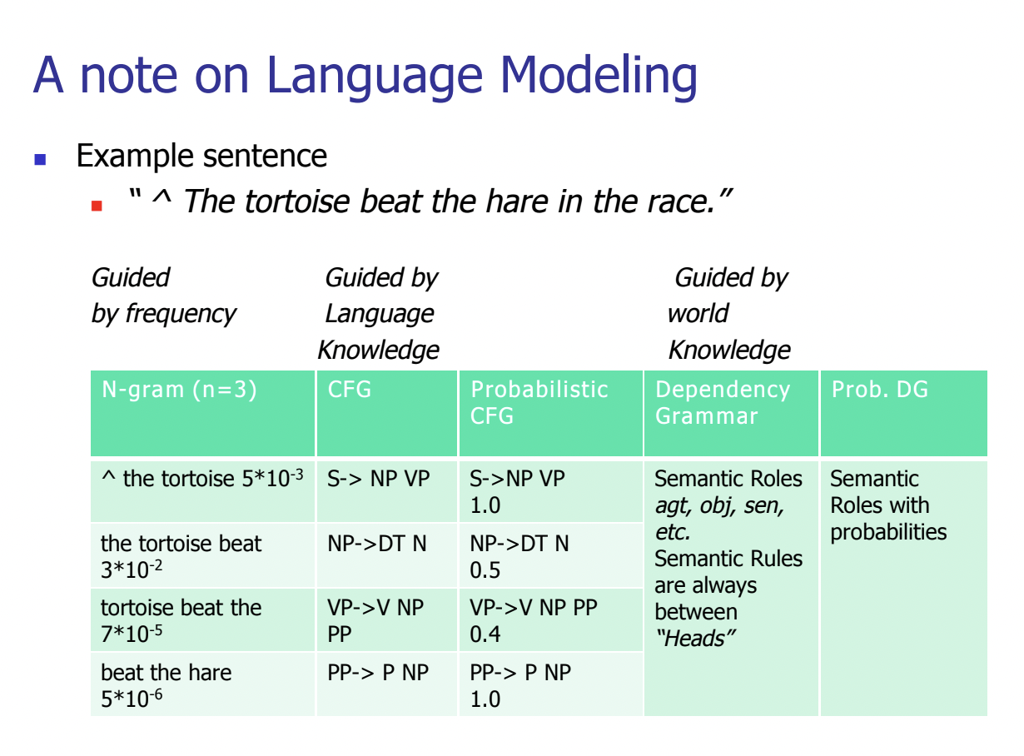
N-GRAM LANGUAGE MODEL
Food for thought
Slides adapted from CS626: NLP, Speech and the Web, 2013, Prof. Pushpak Bhattacharyya CSE Dept, IIT Bombay

Slide 53
Neural Language Model
A neural probabilistic language model

Slide 54
Neural Language Model
Motivation
Existing n-gram language models fails to capture similarity between words
Assume we have observed the following sentence:
The dog was running in the backyard
When a new yet similar sentence is encountered the model fails to assign a meaning probability
The puggle was splooting in the patio

Slide 55
Neural Language Model
Fighting the curse of dimensionality with distributed representations
The dog was running in the backyard
The puggle was splooting in the patio
If we knew that puggle is a breed of dog, splooting is an action verb like running, patio and backyard are used to refer to locations, the model can generalize well
A model should use semantic and syntactic information of the past to predict the future

Slide 56
Neural Language Model
Motivation
Many times, we need larger n-gram to capture the right dependency
Atlas, a person from Greek mythology, carries the entire green world on his shoulder.
Atlas, a person from Greek mythology, carry the entire green world on his shoulder.
When the subject is third-person singular, then one must use the singular form of the verb when speaking in the present tense*
*https://www.grammarly.com/blog/grammar-basics-what-is-subject-verb-agreement/#:~:text=How%20does%20subject%2Dverb%20agreement,on%20both%20number%20and%20person.

Slide 57
Neural Language Model
The Curse of Dimensionality
Assume we want to build a 10-gram language model
The vocabulary contains 1M words
The number of parameters required to model the LM would be: (1M¹⁰ – 1) parameters

Slide 58
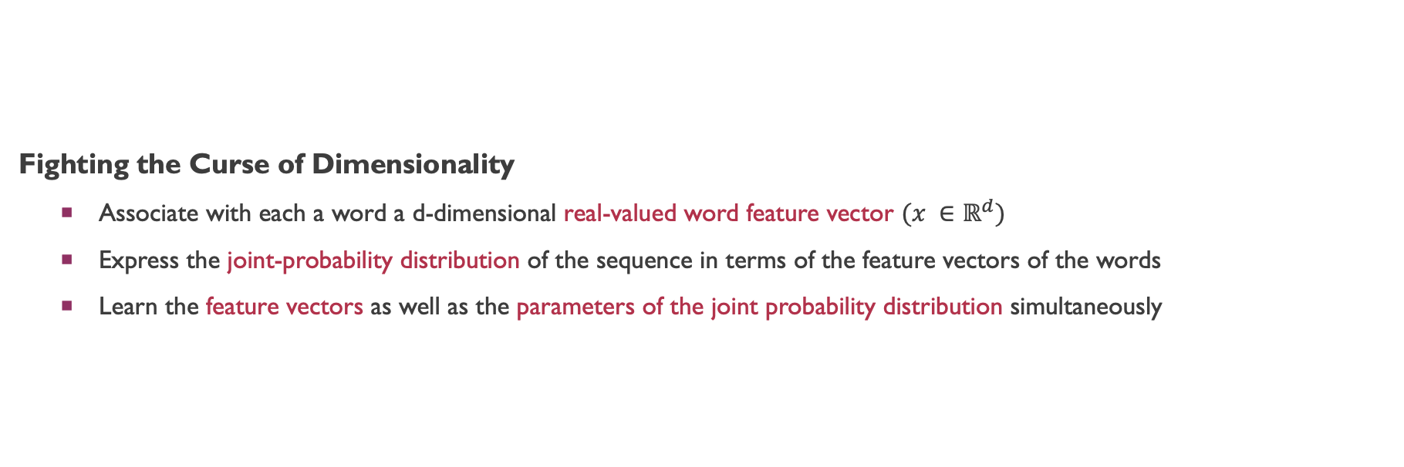
Neural Language Model
Fighting the Curse of Dimensionality
Associate with each a word a d-dimensional real-valued word feature vector $(x ∈ℝ^{d})$
Express the joint-probability distribution of the sequence in terms of the feature vectors of the words
Learn the feature vectors as well as the parameters of the joint probability distribution simultaneously

Slide 59
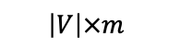
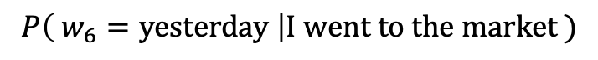
Neural Language Model
$$P\left( w_{6}=\text{yesterday} \right|\text{I} \text{went} \text{to} \text{the} \text{market} )$$
softmax
Summation
Projection
tanh
FFNN
C_{I}
C_{went}
C_{to}
C_{the}
C_{market}
Word Look-Up Table
$$\left|V\right|×m$$
I | went | to | the | market

Slide 60
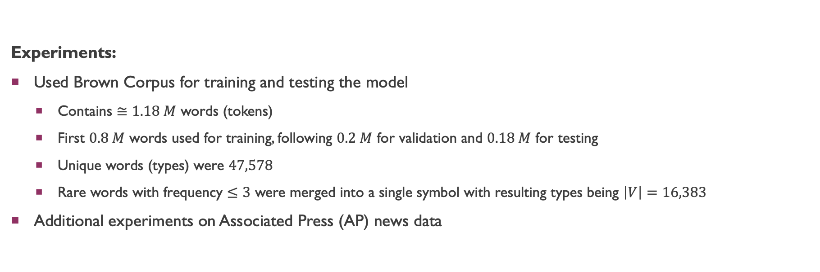
Neural Language Model
Experiments:
Used Brown Corpus for training and testing the model
Contains $≅1.18 M$ words (tokens)
First $0.8 M$ words used for training, following $0.2 M$ for validation and $0.18 M$ for testing
Unique words (types) were $47,578$
Rare words with frequency $≤3$ were merged into a single symbol with resulting types being $\left|V\right|=16,383$
Additional experiments on Associated Press (AP) news data

Slide 61
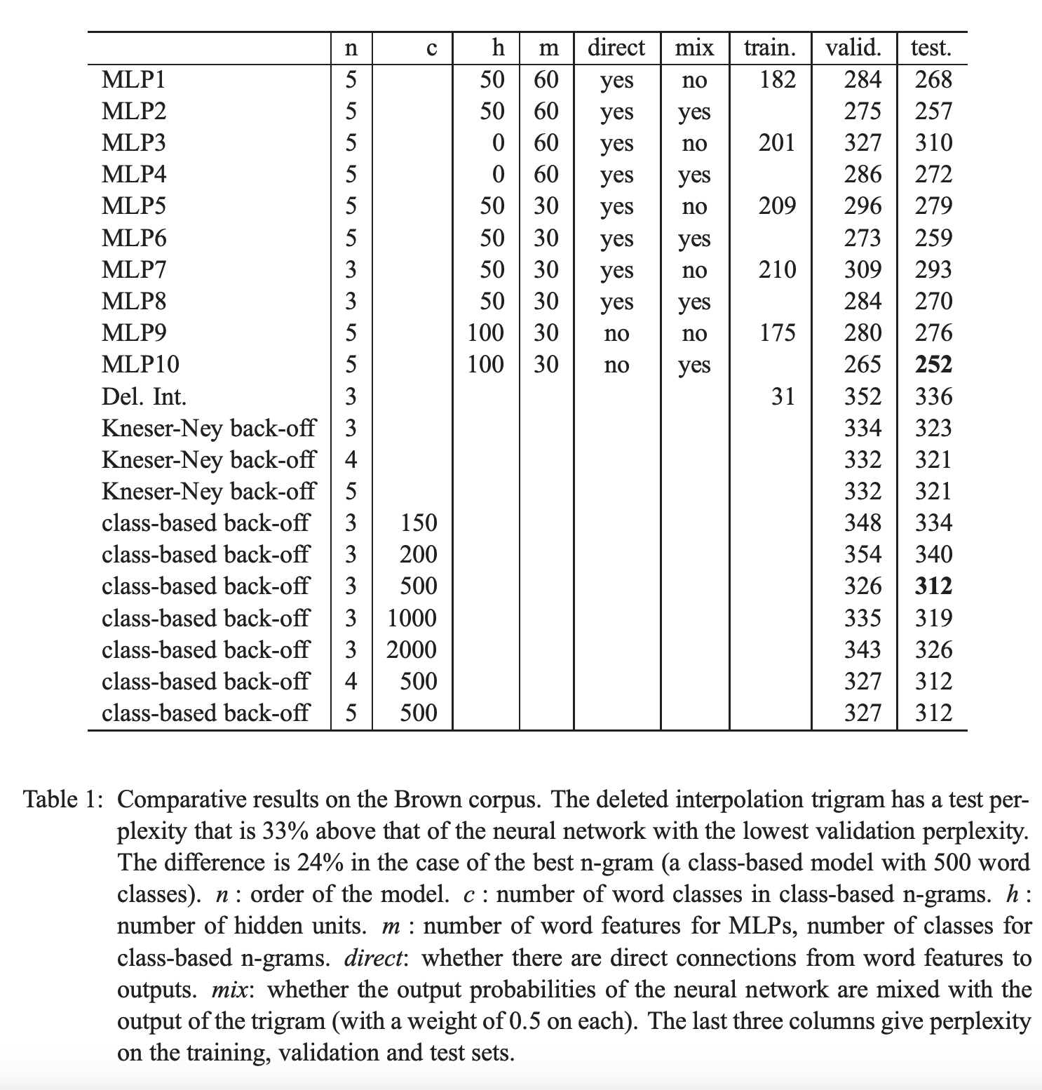
Neural Language Model
Results:
Significant results from Neural Model
Longer contexts leads to better results
Hidden units are beneficial
Mixing MLP with n-gram leads to lower perplexity values

Slide 62
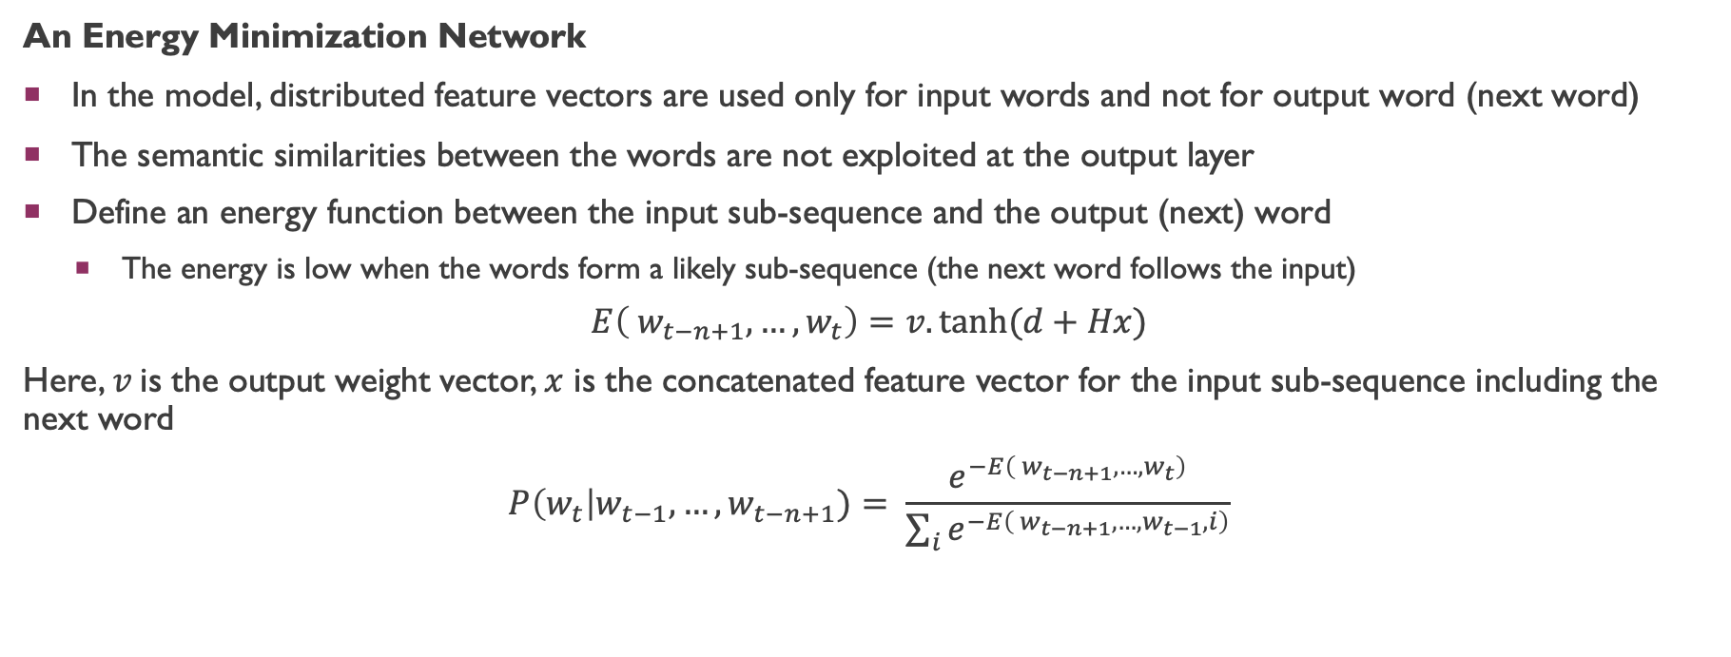
Neural Language Model
An Energy Minimization Network
In the model, distributed feature vectors are used only for input words and not for output word (next word)
The semantic similarities between the words are not exploited at the output layer
Define an energy function between the input sub-sequence and the output (next) word
The energy is low when the words form a likely sub-sequence (the next word follows the input)
$$E\left( w_{t−n+1}, …, w_{t}\right)=v.tanh⁡(d+Hx)$$
Here, $v$is the output weight vector, $x$ is the concatenated feature vector for the input sub-sequence including the next word
$$P\left(w_{t}\right|w_{t−1}, …, w_{t−n+1})= \frac{e^{−E\left( w_{t−n+1}, …, w_{t}\right)}}{\sum_{i}{e^{−E\left( w_{t−n+1}, …, w_{t−1}, i\right)}}}$$

Slide 63
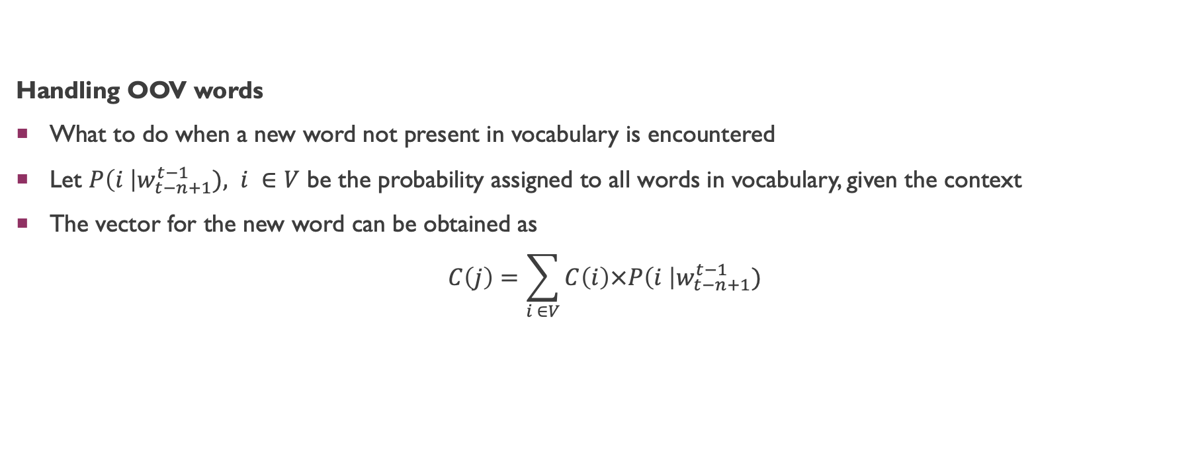
Neural Language Model
Handling OOV words
What to do when a new word not present in vocabulary is encountered
Let $P\left(i \right|w_{t−n+1}^{t−1}), i ∈V$ be the probability assigned to all words in vocabulary, given the context
The vector for the new word can be obtained as
$$C\left(j\right)=\sum_{i ∈V}{C\left(i\right)×P\left(i \right|w_{t−n+1}^{t−1})}$$

Slide 64
Neural Language Model
Future Work
Representing the conditional probability with a tree structure. Reduces the expensive softmax computation cost (Hierarchical Softmax)
Propagating gradients only from a subset of the output words (Negative Sampling)
Capture longer context by using either Time-Delay Neural Network or Recurrent Neural Network
Interpreting word feature representations learned by the model. Begin with 2-dimensional representation as it can be easily visualized

Slide 65
Neural Language Model
The idea of Hierarchical softmax (Bengio 2002) was incorporated by Mnih and Hinton, 2008 and later by Mikholov et.al 2011
Propagating gradients only from a subset of the output words was used by Collobert and Weston, 2008 and later Mikholov et.al 2011
Capture longer context by using either Time-Delay Neural Network or Recurrent Neural Network was incorporated by Collobert and Weston, 2008 and later Mikholov et.al 2011

Slide 66
Neural Language Model
Recurrent neural network based language model

Slide 67
Recurrent neural network based language model
Motivation
Feedforward NN have the limitations of being able use a fixed length context
कुमार जो मेरे पापा के दोस्त का बेटा है और पिछले हफ्ते हमारे घर आया था, वो फरीदाबाद के पीछे वाली गली के रामजी के दूकान के बाजूवाले किराणा मैं मिला था |
Ability to learn long-range dependencies

Slide 68
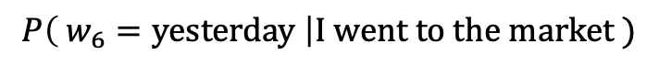
Recurrent neural network based language model
$$P\left( w_{6}=\text{yesterday} \right|\text{I} \text{went} \text{to} \text{the} \text{market} )$$
Elman Network for Language Modeling
softmax
Linear
sigmoid
Linear
Linear
Linear
Linear
Linear
C_{I}
C_{went}
C_{to}
C_{the}
C_{market}
Word Look-Up Table
I | went | to | the | market

Slide 69
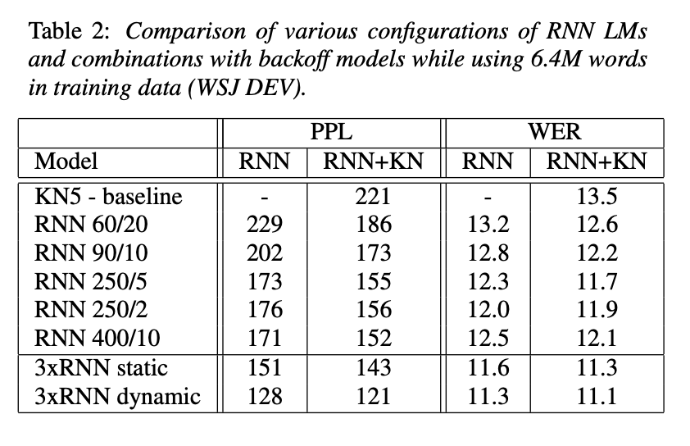
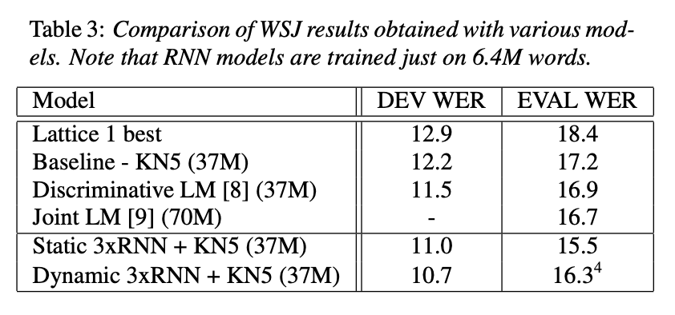
Recurrent neural network based language model

Slide 70
Generating Sequences With LSTM (Graves 2013)
Graves demonstrated how LSTMs can be trained for Language modeling task
Andrej Karpathy demonstrated how LSTMs can be trained on character-level LM and the LM can generate interesting generations*
*http://karpathy.github.io/2015/05/21/rnn-effectiveness/

Slide 71
Unsupervised Pre-Training
A fast learning algorithm for deep belief nets
Greedy Layer-Wise Training of Deep Networks

Slide 72
Greedy Layer-Wise TraininG
How to train large Deep Neural Networks weren’t clear
Gradient-based optimization often got stuck in local minima leading to sub-optimal results
Training each layer as an auto-encoder leads to better initialization of the model
Fine-tuning the entire network after greedy layer-wise pre-training leads to better performance
Without pre-training, the bulk of the task was performed by the top layers
The lower layers learn more meaningful representation of the input during pre-training

Slide 73
Greedy Layer-Wise TraininG
A typical Deep Neural Network Model
Softmax/Sigmoid/…
Output Layer
How do we initialize the encoder parameters?
Encoder
How do we initialize the word look-up Table?
C_{I}
C_{liked}
C_{the}
C_{movie}
C_{prey}
LM-LSTM, SA-LSTM, ELMO, BERT,
Word Look-Up Table
Word2vec, glove, fasttext, …
I | liked | the | movie, | prey

Slide 74
Conclusion
We have looked at traditional n-gram language models
We have discussed FFNN and RNN based language models
Computation was the bottleneck, and these approaches were designed keeping that in mind
These serve as the foundations to existing advanced language models

Slide 75
Word Embeddings
PREDICTION-BASED APproaches

Slide 76
Neural Language Model
$$P\left( w_{6}=\text{yesterday} \right|\text{I} \text{went} \text{to} \text{the} \text{market} )$$
softmax
Summation
Projection
tanh
FFNN
C_{I}
C_{went}
C_{to}
C_{the}
C_{market}
Word Look-Up Table
$$\left|V\right|×m$$
I | went | to | the | market

Slide 77
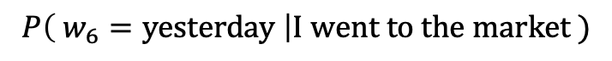
Neural Language Model → word2vec
Replace FFNN with summation, drop non-linearity
$$P\left( w_{6}=\text{yesterday} \right|\text{I} \text{went} \text{to} \text{the} \text{market} )$$
softmax
Summation
C_{I}
C_{went}
C_{to}
C_{the}
C_{market}
Word Look-Up Table
$$\left|V\right|×m$$
I | went | to | the | market

Slide 78
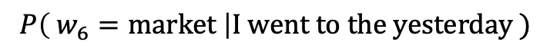
Neural Language Model → word2vec
Mask the middle word in the sentence
Replace FFNN with summation, drop non-linearity
$$P\left( w_{6}=\text{market} \right|\text{I} \text{went} \text{to} \text{the} \text{yesterday} )$$
softmax
Sum
C_{I}
C_{went}
C_{to}
C_{the}
C_{yesterday}
Word Look-Up Table
$$\left|V\right|×m$$
I | went | to | the | yesterday

Slide 79
Word2vec
Continuous Bag-of-Words (CBOW)
Skigram
Output
Inputs
the | Look-up Table | w_{the}
cat |  | w_{cat}
ate
a |  | w_{a}
mice |  | w_{mice}
Inputs
 | Look-up Table
ate |  | w_{ate}
w_{the} | the
w_{cat} | cat
w_{a} | a
w_{mice} | mice
Output
Sum
w_{ate}
ate

Slide 80
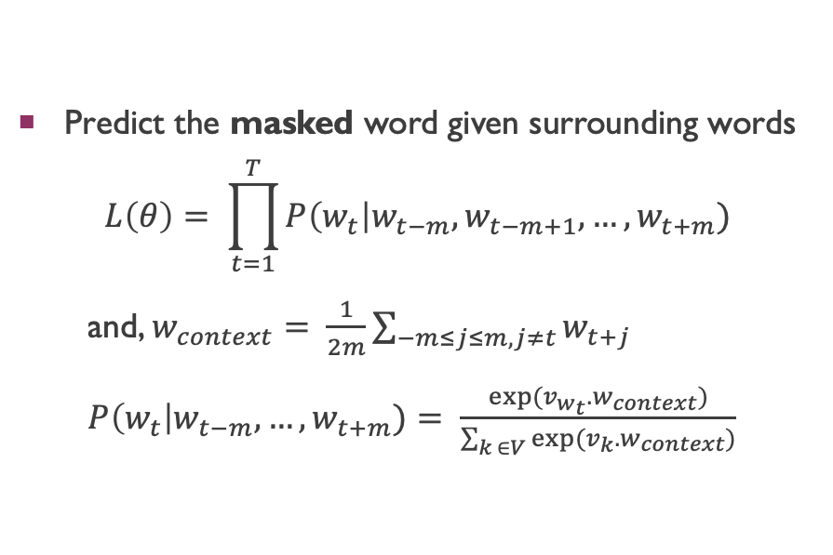
CBOW
Continuous Bag-of-Words (CBOW)
Predict the masked word given surrounding words
$$L\left(θ\right)= \prod_{t=1}^{T}{P\left(w_{t}\right|w_{t−m},w_{t−m+1}, …,w_{t+m})}$$
and, $w_{context}= \frac{1}{2m}\sum_{−m≤j≤m, j≠t}{w_{t+j}}$
$P\left(w_{t}\right|w_{t−m},…,w_{t+m})= \frac{exp⁡(v_{w_{t}}. w_{context})}{\sum_{k ∈V}{exp⁡(v_{k}. w_{context})}}$
Inputs
the | Look-up Table | w_{the}
cat |  | w_{cat}
ate
a |  | w_{a}
mice |  | w_{mice}
Output
Sum
w_{ate}

Slide 81
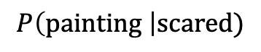
Skipgram
Skigram
Use the word to predict the surrounding words
Usually a fixed window on either side is used
Output
Inputs
 | Look-up Table
ate |  | w_{ate}
w_{the} | the
w_{cat} | cat
w_{a} | a
w_{mice} | mice
$$P\left(\text{painting} \right|\text{scared})$$
I | have | been | scared | by | that | painting | before | too

Slide 82
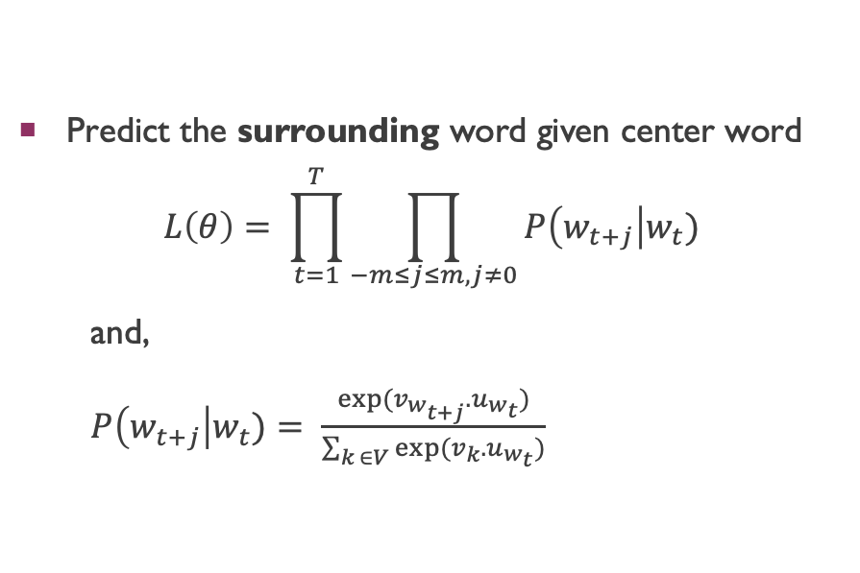
Skipgram
Skigram
Predict the surrounding word given center word
$$L\left(θ\right)= \prod_{t=1}^{T}{\prod_{−m≤j≤m, j≠0}{P\left(w_{t+j}\right|w_{t})}}$$
and,
$P\left(w_{t+j}\right|w_{t})= \frac{exp⁡(v_{w_{t+j}}.u_{w_{t}})}{\sum_{k ∈V}{exp⁡(v_{k}.u_{w_{t}})}}$
Output
Inputs
 | Look-up Table
ate |  | w_{ate}
w_{the} | the
w_{cat} | cat
w_{a} | a
w_{mice} | mice

Slide 83
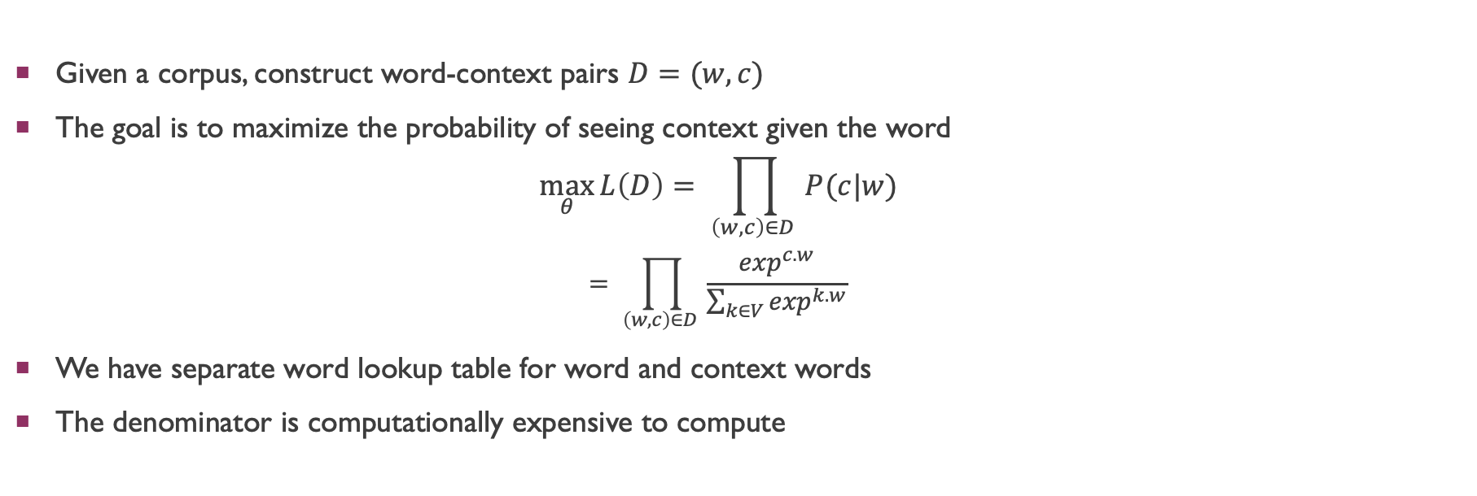
Word2vec Training
Given a corpus, construct word-context pairs $D=(w,c)$
The goal is to maximize the probability of seeing context given the word $\max_{θ}{L\left(D\right)= \prod_{\left(w,c\right)∈D }{P(c|w)}}$
$$= \prod_{\left(w,c\right)∈D }{\frac{\exp^{c.w}}{\sum_{k∈V}{\exp^{k.w}}}}$$
We have separate word lookup table for word and context words
The denominator is computationally expensive to compute

Slide 84
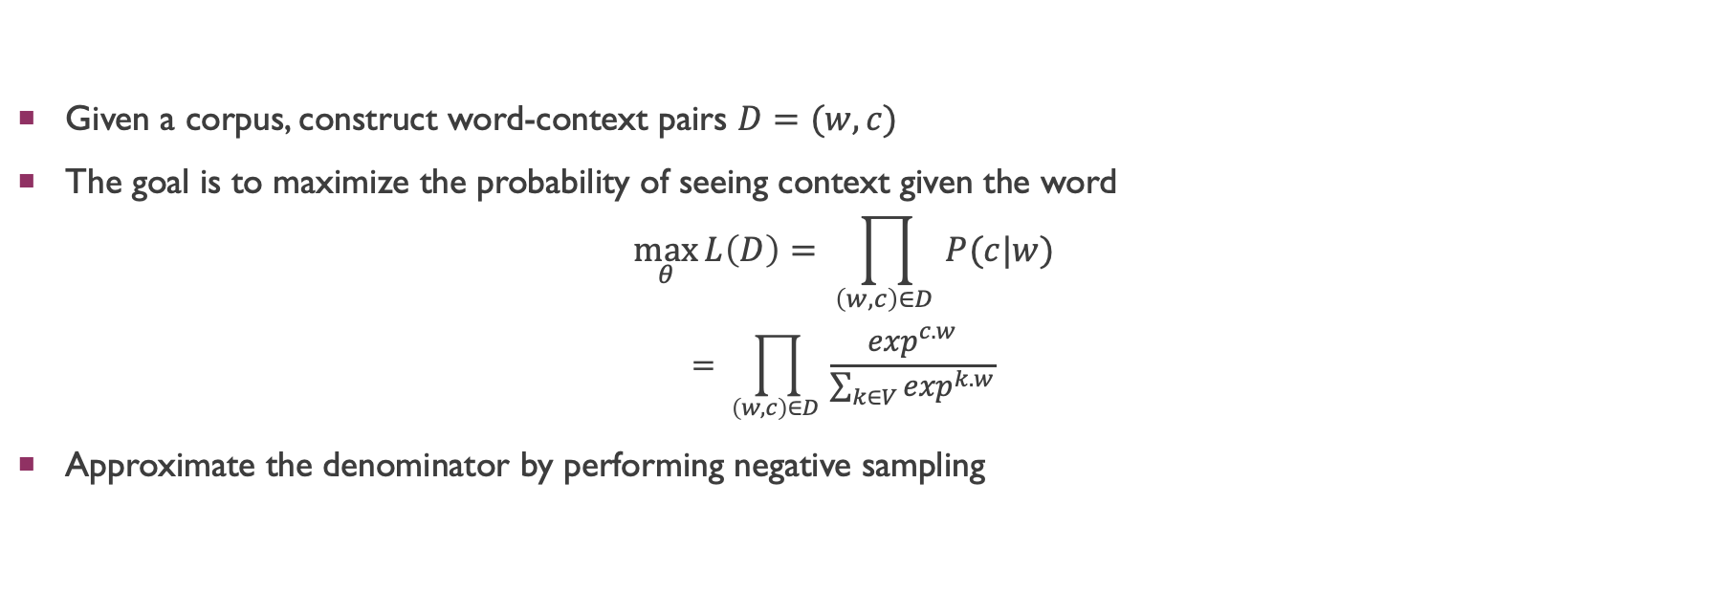
Word2vec Training
Given a corpus, construct word-context pairs $D=(w,c)$
The goal is to maximize the probability of seeing context given the word $\max_{θ}{L\left(D\right)= \prod_{\left(w,c\right)∈D }{P(c|w)}}$
$$= \prod_{\left(w,c\right)∈D }{\frac{\exp^{c.w}}{\sum_{k∈V}{\exp^{k.w}}}}$$
Approximate the denominator by performing negative sampling

Slide 85
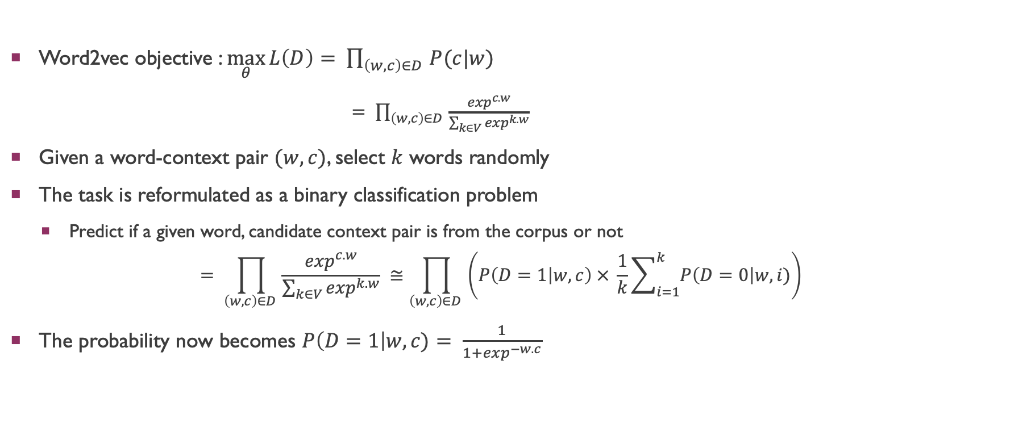
Negative Sampling
Word2vec objective : $\max_{θ}{L\left(D\right)= \prod_{\left(w,c\right)∈D }{P(c|w)}}$
$= \prod_{\left(w,c\right)∈D }{\frac{\exp^{c.w}}{\sum_{k∈V}{\exp^{k.w}}}}$
Given a word-context pair $(w,c)$, select $k$ words randomly
The task is reformulated as a binary classification problem
Predict if a given word, candidate context pair is from the corpus or not
$$= \prod_{\left(w,c\right)∈D }{\frac{\exp^{c.w}}{\sum_{k∈V}{\exp^{k.w}}}} ≅\prod_{\left(w,c\right)∈D }{\left(P\left(D=1 | w,c\right) × \frac{1}{k}\sum_{i=1}^{k}{P\left(D=0\right|w,i)}\right)}$$
The probability now becomes $P\left(D=1\right|w,c)= \frac{1}{1+\exp^{−w.c}}$

Slide 86
Fasttext Embeddings

Slide 87
Fasttext Embeddings
word2vec treats each word as a separate token
In morphologically-rich languages, the same root word takes multiple inflections
ಕುಮಾರ, ಕುಮಾರನು, ಕುಮಾರನಿಂದ, ಕುಮಾರನಿಗೆ, ….
The above words will have different embeddings and maybe very far-away in the embedding space
A word embedding model which ensures that words with similar spellings have similar representations ?
How about ಮರವನ್ನು vs ಸರವನ್ನು ?

Slide 88
Fasttext Embeddings
The approach is similar to skip-gram or cbow, but a word embedding is composed of
Embedding of itself
Embedding of character n-grams
Here, we observe how the embedding for the word ಕುಮಾರನು when we consider n-gram of 3
ಕುಮಾರನು
+
<ಕುಮಾ
ಕುಮಾರ
ಮಾರನು
ರನು>
<ಕುಮಾರನು>

Slide 89
FASTTEXT EMBEDDINGS
word2vec: https://code.google.com/archive/p/word2vec/
FastText: https://fasttext.cc/
Glove: https://nlp.stanford.edu/projects/glove/

Slide 90
Multilingual EMbedding
Offline Methods
Online METHODs

Slide 91
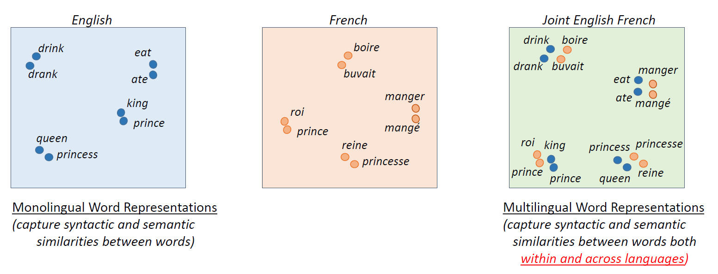
embed(x) = embed(y) + ϵ
x, y are source and target words
embed(w): embedding for word w
(Source: Khapra and Chandar, 2016)

Slide 92
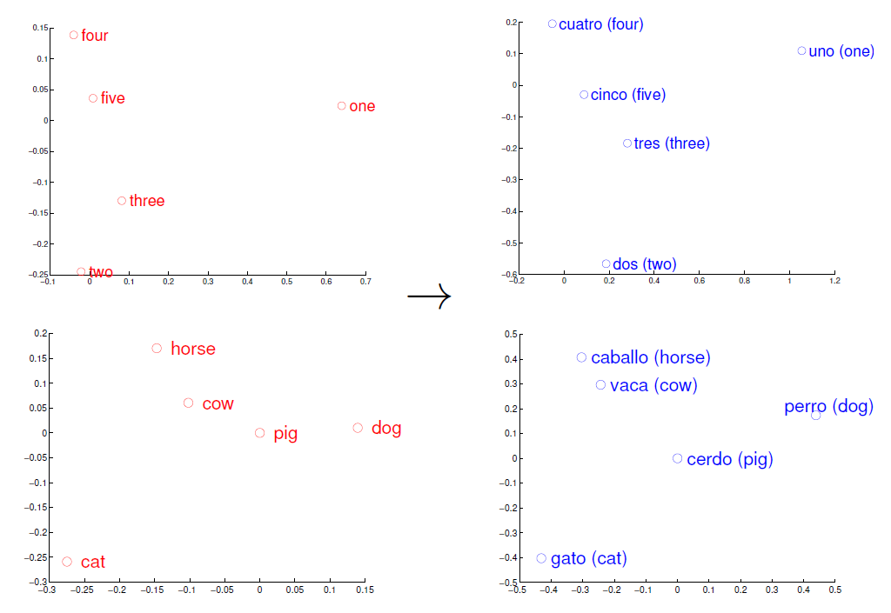
Is it possible to learn Mappings
Languages share concepts ground in the real world
Some evidence of universal semantic structure (Youn et al., 2016)
Isomorphism between embedding spaces (Mikolov et al., 2013)
Isomorphism can be captured via a linear transformation
(Source: Mikolov et al., 2013)

Slide 93
Offline Methods
Learn monolingual and cross-lingual embeddings separately
General require weaker parallel signals
e.g., bilingual dictionaries
Online Methods
Learn monolingual and cross-lingual embeddings jointly
Generally require stronger parallel signals
e.g., parallel corpus

Slide 94
Multilingual EMbedding
Offline Methods
Online METHODs

Slide 95

Supervised Learning

Slide 96

Supervised Learning
Least Squares Solution (Mikolov, 2013)
Orthogonality Constraint on W (Artetxe et.al., 2016; Smith et.al., 2017; Xing et.al., 2015)
Canonical Correlation Analysis (Faruqui and Dyer, 2014; Ammar et al. 2015)

Slide 97
Multilingual EMbedding
Offline Methods
Online METHODs

Slide 98

English-Hindi Parallel Data

Slide 99

A general framework for cross-lingual embeddings
Offline embeddings also follow this framework,
but they optimize the monolingual and bilingual objectives sequentially

Slide 100


Slide 101


Slide 102
Word Embedding Evaluation

Slide 103
Word Embedding Evaluation
Intrinsic Evaluation
Extrinsic Evaluation

Slide 104
Intrinsic Evaluation
Evaluate the word embedding directly
Fast to compute
Unsure how it correlates with the downstream task

Slide 105
Intrinsic Evaluation
Word Similarity
Wordsim-353
353 word pairs with human judgement
http://alfonseca.org/eng/research/wordsim353.html
Use Spearman Correlation
Word 1 | Word 2 | Human Judgement
tiger | cat | 7.35
tiger | tiger | 10.00
plane | car | 5.77
train | car | 6.31
television | radio | 6.77
media | radio | 7.42
bread | butter | 6.19

Slide 106
Intrinsic Evaluation
Word Relatedness
Wordrel-353
353 word pairs with human judgement
http://alfonseca.org/eng/research/wordsim353.html
Use Spearman Correlation
Word 1 | Word 2 | Human Judgement
computer | keyboard | 7.62
Jerusalem | Israel | 8.46
planet | galaxy | 8.11
day | summer | 3.94
day | dawn | 7.53
planet | people | 5.75
minister | party | 6.63

Slide 107


Word Analogy
man: woman ≈ king: ?
$a\text{rg} \max_{i} \left(\cos\left(u_{i}, u_{b} − u_{a}+ u_{c}\right)\right)$
Semantic:
India:rupee :: China:?
Syntactic:
bad:good :: cool:?
http://download.tensorflow.org/data/questions-words.txt
Ethayarajh et al., ACL 2019

Slide 108
EXtrinsic Evaluation
Use word embeddings as features in downstream tasks like
Named Entity Recognition
Machine Translation
Question Answering
…

Slide 109
Debiasing Word Embeddings

Slide 110

https://www.theguardian.com/technology/2017/apr/13/ai-programs-exhibit-racist-and-sexist-biases-research-reveals

Slide 111

https://news.stanford.edu/2018/04/03/algorithms-reveal-changes-stereotypes/

Slide 112

BiAs in Word Embeddings
$\overset{→}{man}$ - $\overset{→}{woman}$ ≈ $\overset{→}{king}$ – $\overset{→}{queen}$ ✅
$\overset{→}{man}$ - $\overset{→}{woman}$ ≈ $\overset{→}{computer programmer}$ – $\overset{→}{homemaker}$
Man is to computer programmer as woman is to homemaker? debiasing word embeddings.
Tolga Bolukbasi, Kai-Wei Chang, James Zou, Venkatesh Saligrama, Adam Kalai. NIPS 2016

Slide 113

BiAs in Word Embeddings
Man is to computer programmer as woman is to homemaker? debiasing word embeddings.
Tolga Bolukbasi, Kai-Wei Chang, James Zou, Venkatesh Saligrama, Adam Kalai. NIPS 2016

Slide 114

BiAs in Word Embeddings
Man is to computer programmer as woman is to homemaker? debiasing word embeddings.
Tolga Bolukbasi, Kai-Wei Chang, James Zou, Venkatesh Saligrama, Adam Kalai. NIPS 2016

Slide 115


BiAs in Word Embeddings
Word embeddings quantify 100 years of gender and ethnic stereotypes.
Nikhil Garg, Londa Schiebinger, Dan Jurafsky, and James Zou

Slide 116
Word Embeddings reflect the bias existing in society

Slide 117

Testing for BIAS
Similarity Tests
Is the embedding of nurse similar to man or woman?
Analogy Tests
$\overset{→}{man}$ - $\overset{→}{woman}$ ≈ $\overset{→}{engineer}$ – $?$

Slide 118

WEAT implicit Association Test
Given set of target words
X = {programmer, engineer, scientist, …}
Y = {nurse, teacher, librarian, …}
Given set of attribute words
A = {man, male, …}
B = {woman, female, …}
$s\left(X, Y, A, B\right)=\sum_{x ∈X}{s\left(x, A, B\right)} − \sum_{y ∈Y}{s(y, A, B)}$ where
$s\left(w, A, B\right)= {\text{mean}}_{a ∈A} \cos{(w,a)} −{\text{mean}}_{b ∈B} \cos{(w,b)}$
Caliskan et al; Semantics derived automatically from language corpora
contain human like biases. Science 2017

Slide 119
Conclusion
Distributed representation of words
Approaches to get such distributed representations
Bias in such representations

Slide 120
References
Weaver, W. (1955). Translation. In W.N. Locke and D.A. Booth (eds.), Machine Translation of Languages, Cambridge, MA: MIT Press.
Firth, J.R. (1957). A synopsis of linguistic theory 1930-1955. In Studies in Linguistic Analysis, pp. 1-32. Oxford: Philological Society. Reprinted in F.R. Palmer (ed.), Selected Papers of J.R. Firth 1952-1959, London: Longman (1968).
Harris, Z. (1954). Distributional structure. Word, 10(23): 146-162.
Yoshua Bengio, Réjean Ducharme, Pascal Vincent, and Christian Janvin. 2003. A neural probabilistic language model. J. Mach. Learn. Res. 3, null (3/1/2003), 1137–1155.

Slide 121
References
Mikolov T, Sutskever I, Chen K, Corrado GS, Dean J. Distributed representations of words and phrases and their compositionality. Advances in neural information processing systems. 2013;26.
Mikolov T, Chen K, Corrado G, Dean J. Efficient estimation of word representations in vector space. arXiv preprint arXiv:1301.3781. 2013 Jan 16.
Mikolov T, Yih WT, Zweig G. Linguistic regularities in continuous space word representations. InProceedings of the 2013 conference of the north american chapter of the association for computational linguistics: Human language technologies 2013 Jun (pp. 746-751).
Tomas Mikolov, Martin Karafiat, Jan Cernocky, and Sanjeev Khudanpur. 2010. Recurrent neural network based language model. In Proceedings of Interspeech 2010.

Slide 122
References
Bojanowski, Piotr, Edouard Grave, Armand Joulin, and Tomas Mikolov. "Enriching word vectors with subword information." Transactions of the association for computational linguistics 5 (2017): 135-146.
Towards Understanding Linear Word Analogies. Ethayarajh et al., ACL 2019
Ammar, W., Mulcaire, G., Tsvetkov, Y., Lample, G., Dyer, C., and Smith, N. A. (2016). Massively multilingual word embeddings. In ACL.
Anoop Kunchukuttan, Multilingual Learning, 3rd Summer School on Machine Learning (Advances in Modern AI), IIIT Hyderabad, 2018
Artetxe, M., Labaka, G., and Agirre, E. (2016). Learning principled bilingual mappings of word embeddings while preserving monolingual invariance. In Proceedings of the 2016 Conference on Empirical Methods in Natural Language Processing, pages 2289--2294, Austin, Texas. Association for Computational Linguistics.
Artetxe, M., Labaka, G., and Agirre, E. (2017). Learning bilingual word embeddings with (almost) no bilingual data. In Proceedings of the 55th Annual Meeting of the Association for Computational Linguistics (Volume 1: Long Papers), pages 451--462. Association for Computational Linguistics.

Slide 123
References
Artetxe, M., Labaka, G., and Agirre, E. (2018a). Generalizing and improving bilingual word embedding mappings with a multi-step framework of linear transformations. In Proceedings of the Thirty-Second AAAI Conference on Artificial Intelligence, pages 5012--5019.
Artetxe, M., Labaka, G., and Agirre, E. (2018b). A robust self-learning method for fully unsupervised cross-lingual mappings of word embeddings. In Proceedings of the 56th Annual Meeting of the Association for Computational Linguistics (Volume 1: Long Papers).
Chandar, S., Lauly, S., Larochelle, H., Khapra, M., Ravindran, B., Raykar, V. C., and Saha, A. (2014). An autoencoder approach to learning bilingual word representations. In Advances in Neural Information Processing Systems, pages 1853--1861.
Conneau, A., Lample, G., Ranzato, M., Denoyer, L., and Jégou, H. (2018). Word translation without parallel data. In International Conference on Learning Representations.
Coulmance, J., Marty, J.-M., Wenzek, G., & Benhalloum, A. (2015). Trans-gram, Fast Cross-lingual Word-embeddings. EMNLP 2015, (September), 1109–1113
Duong, L., Kanayama, H., Ma, T., Bird, S., and Cohn, T. (2017). Multilingual training of crosslingual word embeddings. In Proceedings of the 15th Conference of the European Chapter of the Association for Computational Linguistics, EACL 2017, Valencia, Spain, April 3-7, 2017, Volume 1: Long Papers, pages 894--904.
Faruqui, M. and Dyer, C. (2014). Improving vector space word representations using multilingual correlation. In Proceedings of the 14th Conference of the European Chapter of the Association for Computational Linguistics, pages 462--471.
Gouws, S., Bengio, Y., and Corrado, G. (2015). Bilbowa: Fast bilingual distributed representations without word alignments. In International Conference on Machine Learning, pages 748--756.

Slide 124
References
Hermann, K. M. and Blunsom, P. (2014). Multilingual models for compositional distributed semantics. In ACL.
Huang, K., Gardner, M., Papalexakis, E. E., Faloutsos, C., Sidiropoulos, N. D., Mitchell, T. M., Talukdar, P. P., and Fu, X. (2015). Translation invariant word embeddings. In Proceedings of the 2015 Conference on Empirical Methods in Natural Language Processing, EMNLP 2015, Lisbon, Portugal, September 17-21, 2015, pages 1084--1088.
Lazaridou, A., Dinu, G., and Baroni, M. (2015). Hubness and pollution: Delving into cross-space mapping for zero-shot learning. In Proceedings of the 53rd Annual Meeting of the Association for Computational Linguistics and the 7th International Joint Conference on Natural Language Processing (Volume 1: Long Papers), volume 1, pages 270--280.
Mikolov, T., Le, Q. V., and Sutskever, I. (2013). Exploiting similarities among languages for machine translation. arXiv preprint arXiv:1309.4168.
Mitesh Khapra and Sarath Chandar. Tutorial on Multilingual Multimodal Language Processing Using Neural Networks. NAACL 2016.
Smith, S. L., Turban, D. H. P., Hamblin, S., and Hammerla, N. Y. (2017). Offline bilingual word vectors, orthogonal transformations and the inverted softmax. In ICLR
Xing, C., Wang, D., Liu, C., and Lin, Y. (2015). Normalized word embedding and orthogonal transform for bilingual word translation. In NAACL HLT 2015, The 2015 Conference of the North American Chapter of the Association for Computational Linguistics: Human Language Technologies, Denver, Colorado, USA, May 31 - June 5, 2015, pages 1006--1011.

Slide 125
References
Chapter 3: N-gram Language Models, Speech and Language Processing. Daniel Jurafsky & James H. Martin. Copyright © 2023. All rights reserved. Draft of January 7, 2023
CS 626: NLP, Speech, and the Web, 2013. Pushpak Bhattacharyya. CSE Dept, IIT Bombay
Yoshua Bengio, Réjean Ducharme, Pascal Vincent, and Christian Janvin. 2003. A neural probabilistic language model. J. Mach. Learn. Res. 3, null (3/1/2003), 1137–1155.
Andriy Mnih and Geoffrey Hinton. 2008. A scalable hierarchical distributed language model. In Proceedings of the 21st International Conference on Neural Information Processing Systems (NIPS'08). Curran Associates Inc., Red Hook, NY, USA, 1081–1088.
Collobert R, Weston J. A unified architecture for natural language processing: Deep neural networks with multitask learning. InProceedings of the 25th international conference on Machine learning 2008 Jul 5 (pp. 160-167).

Slide 126
References
Mikolov T, Sutskever I, Chen K, Corrado GS, Dean J. Distributed representations of words and phrases and their compositionality. Advances in neural information processing systems. 2013;26.
Mikolov T, Chen K, Corrado G, Dean J. Efficient estimation of word representations in vector space. arXiv preprint arXiv:1301.3781. 2013 Jan 16.
Mikolov T, Yih WT, Zweig G. Linguistic regularities in continuous space word representations. InProceedings of the 2013 conference of the north american chapter of the association for computational linguistics: Human language technologies 2013 Jun (pp. 746-751).
Tomas Mikolov, Martin Karafiat, Jan Cernocky, and Sanjeev Khudanpur. 2010. Recurrent neural network based language model. In Proceedings of Interspeech 2010.

Slide 127
References
A Bit of Progress in Language Modeling, Joshua Goodman, 2003
Generating Sequences With Recurrent Neural Networks, Alex Graves, 2013
Andrew M. Dai and Quoc V. Le. 2015. Semi-supervised Sequence Learning. In Proceedings of the 28th International Conference on Neural Information Processing Systems - Volume 2 (NIPS'15). MIT Press, Cambridge, MA, USA, 3079–3087.
Hinton, G. E., Osindero, S., & Teh, Y. (2006). A fast learning algorithm for deep belief nets. Neural Computation, 18, 1527–1554.
Elman, J.L. (1990), Finding Structure in Time. Cognitive Science, 14: 179-211. doi:10.1207/s15516709cog1402_1

